Slide 1

Web APIs, gRPC and Kafka on .Net
Tim Oleson

Slide 2

Agenda
Architecture
Web API
gRPC Client/Server
Kafka Intergration

Slide 3

“Abstractions should not depend upon details. Details should depend upon abstractions”
Robert Martin
Solid Principles of Design

Slide 4

Architecture

Slide 5
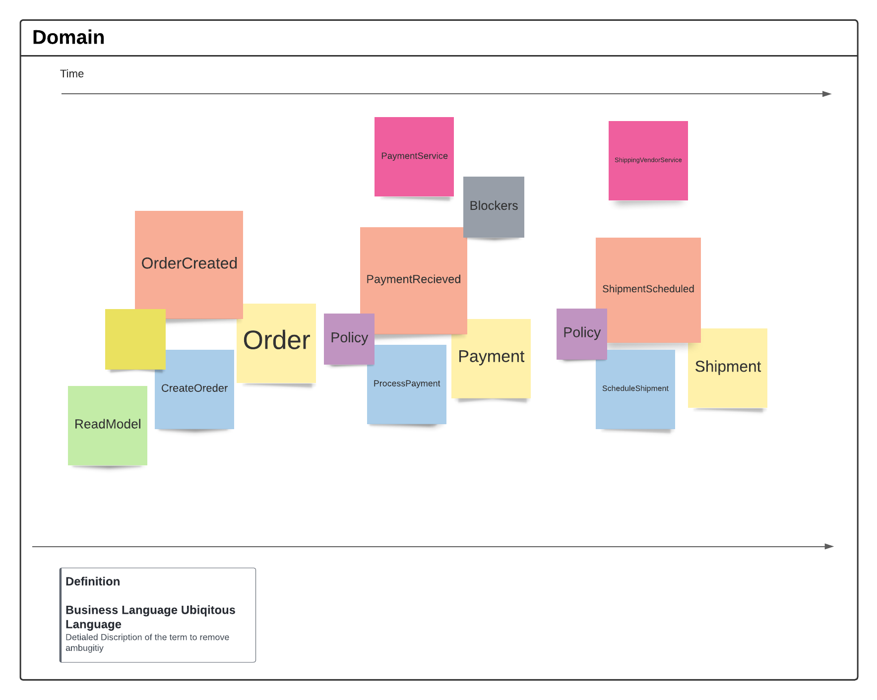
Event Storm

Slide 6
Bounded Context
Orders Bounded Context
Payments Bounded Context
Shipment Bounded Context
Aligned to Business feature
Grouped by Ubiquitous language
Boundary
Order Context
Payment Context
Shipment Context

Slide 7
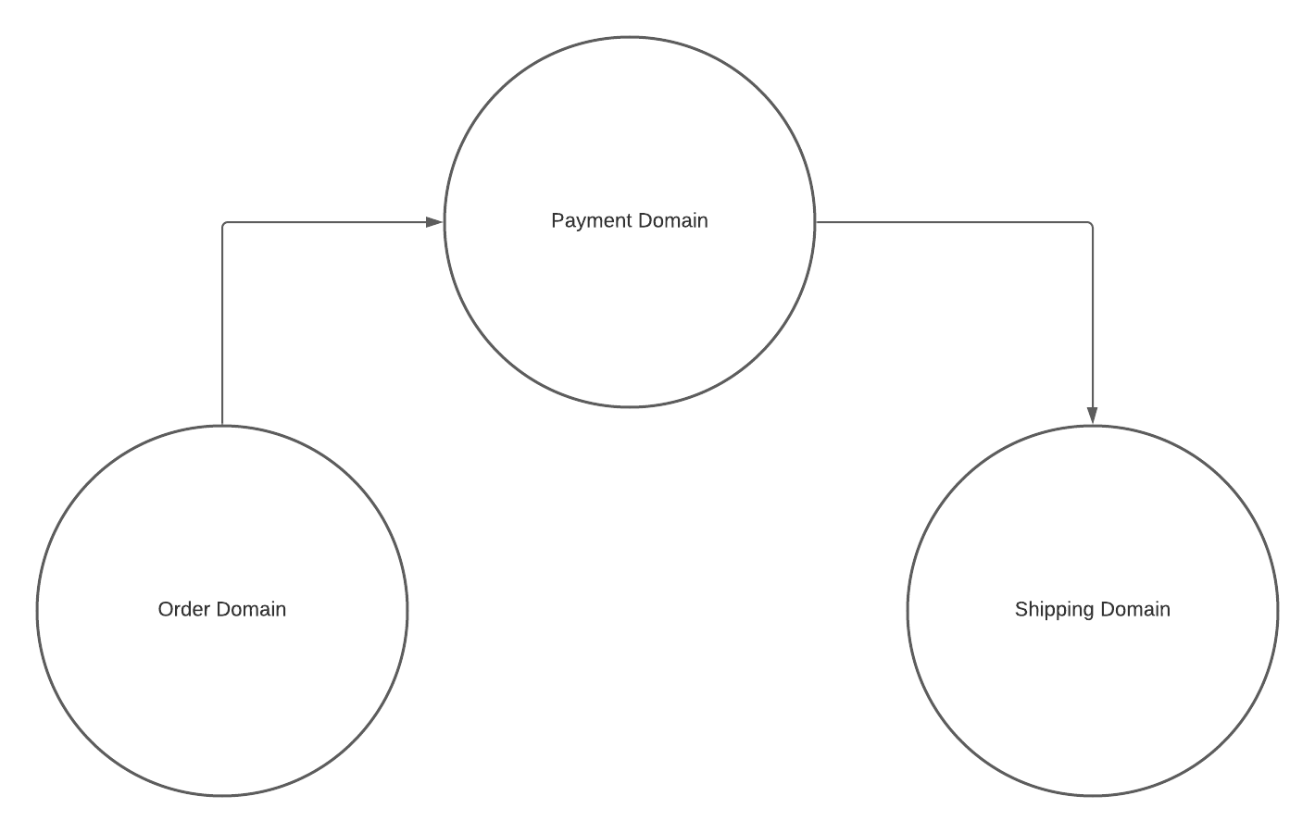
Context Map
Up Stream and Down Stream
Communication Between Services
Communication between teams
Contracts
Model Translation
Each Bounded context has its own language for example order can have different meaning in each context

Slide 8
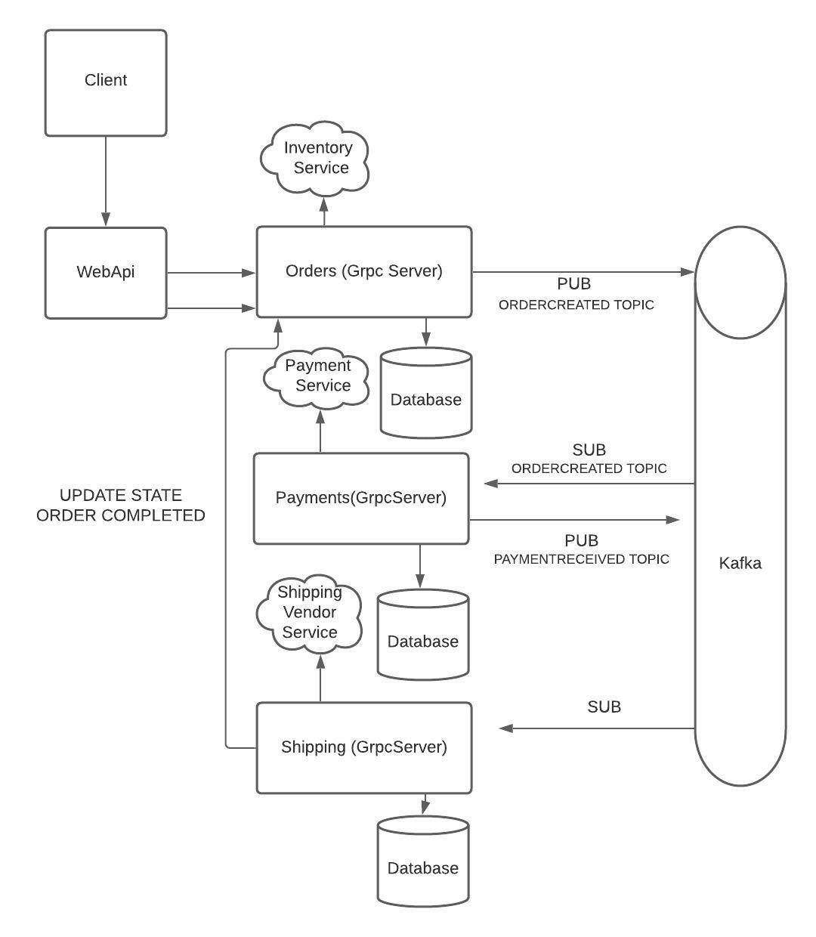
Architecture

Slide 9
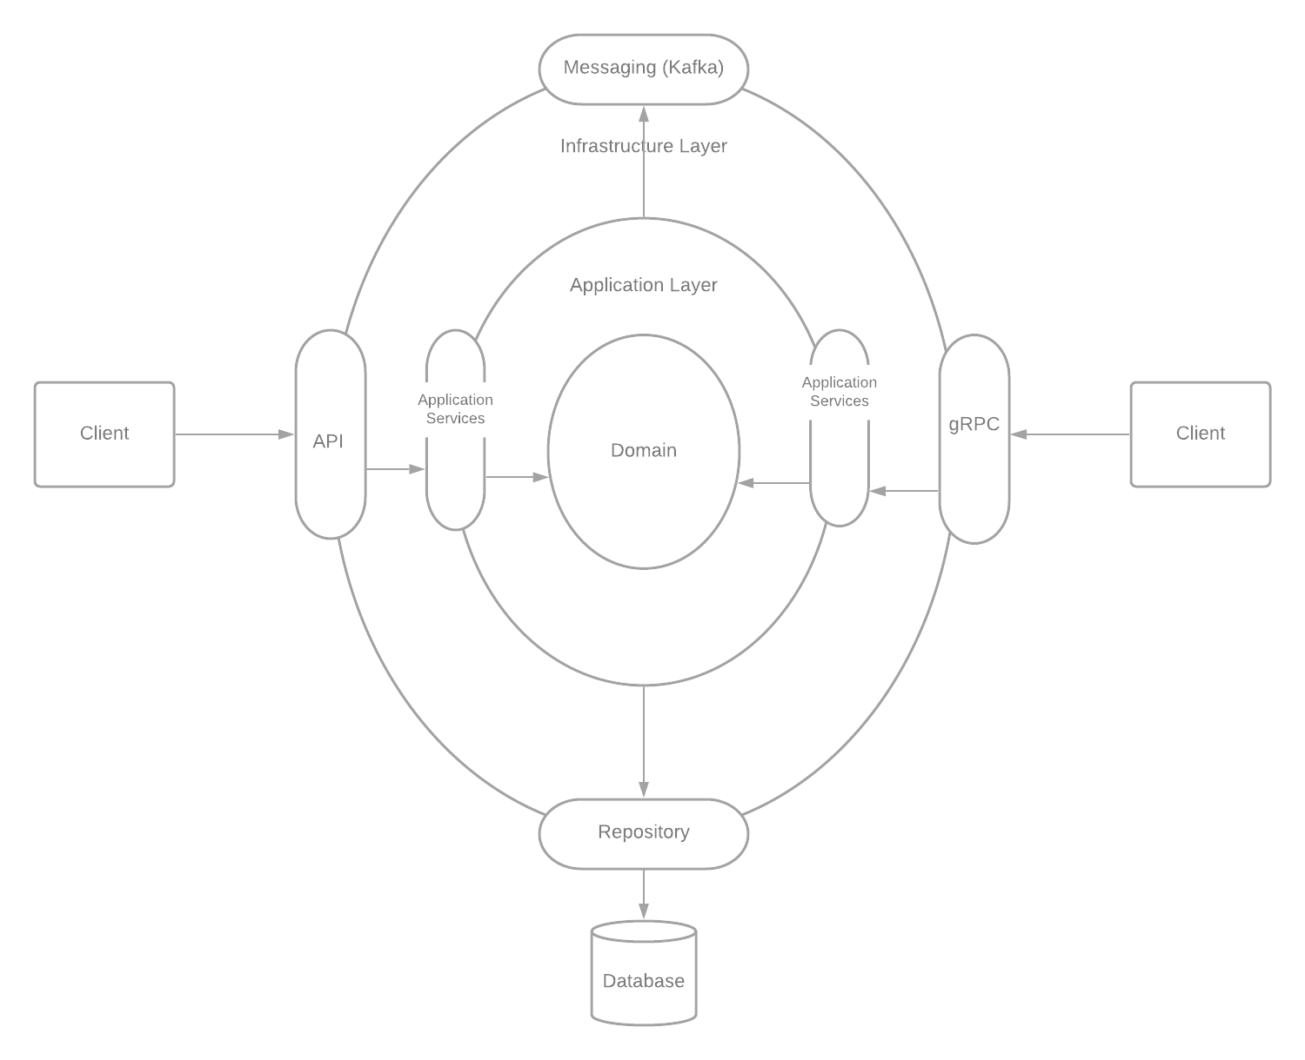
Clean Architecture
Clean Domain Driven Design Onion Architecture
All Dependency point inner ward to the domain layer
Expose internals through a well define interface and contracts
Client streaming
Bi-directional streaming
Streaming calls are specified with the stream keyword in the .proto file. stream can be placed on a call's request message, response message, or both.

Slide 10
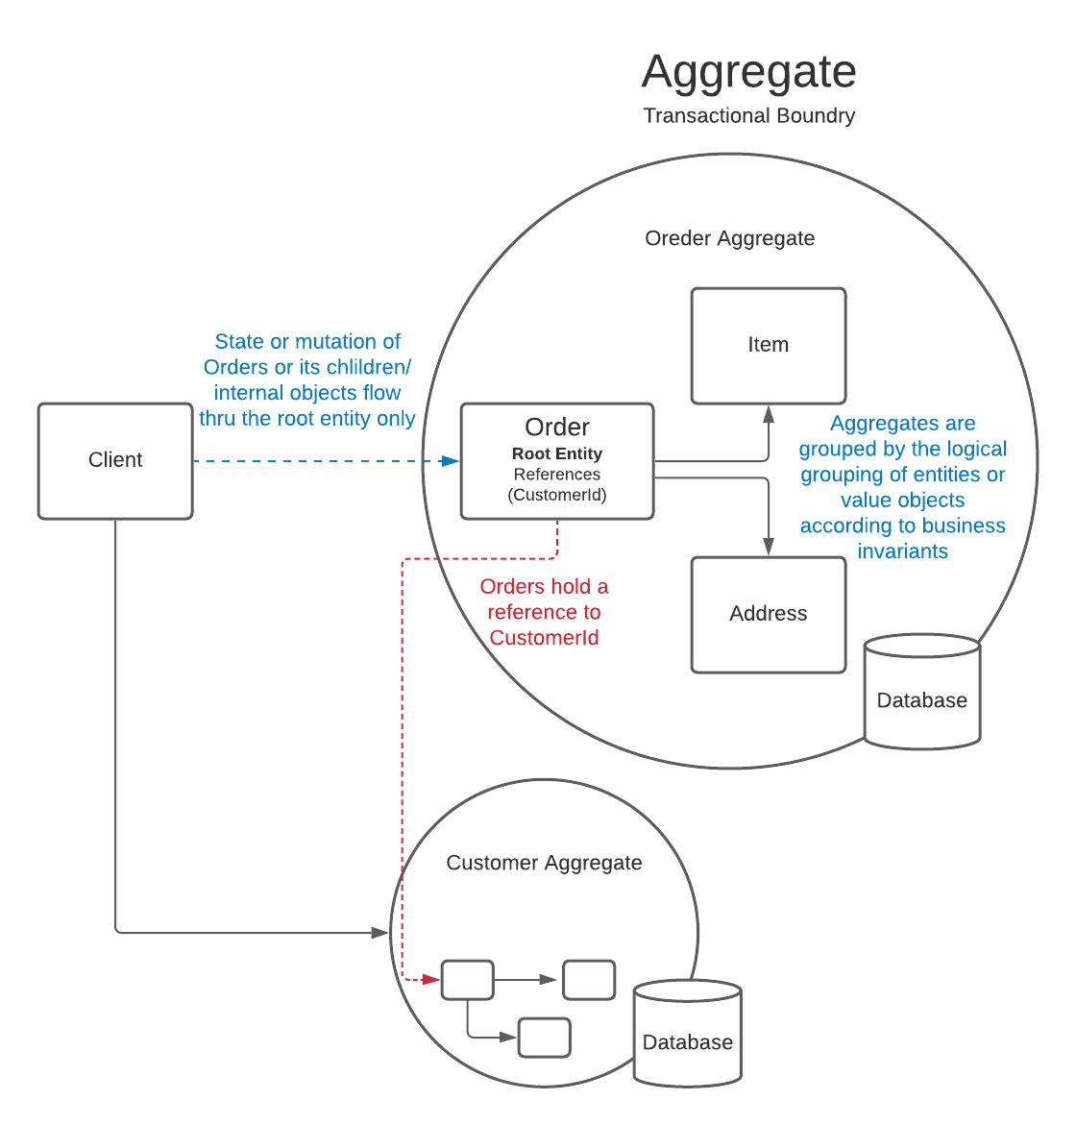
Aggregate Transactional Boundaries
Clients can be External APIs or gRPC Servers
Aggregates can also be an API or gRPC Server
Microservices are made up of aggregates, each microservice with its own transactional boundary
Use Factory Pattern and Repository Pattern
Factory for complex object creation and rehydration
Repository for

Slide 11
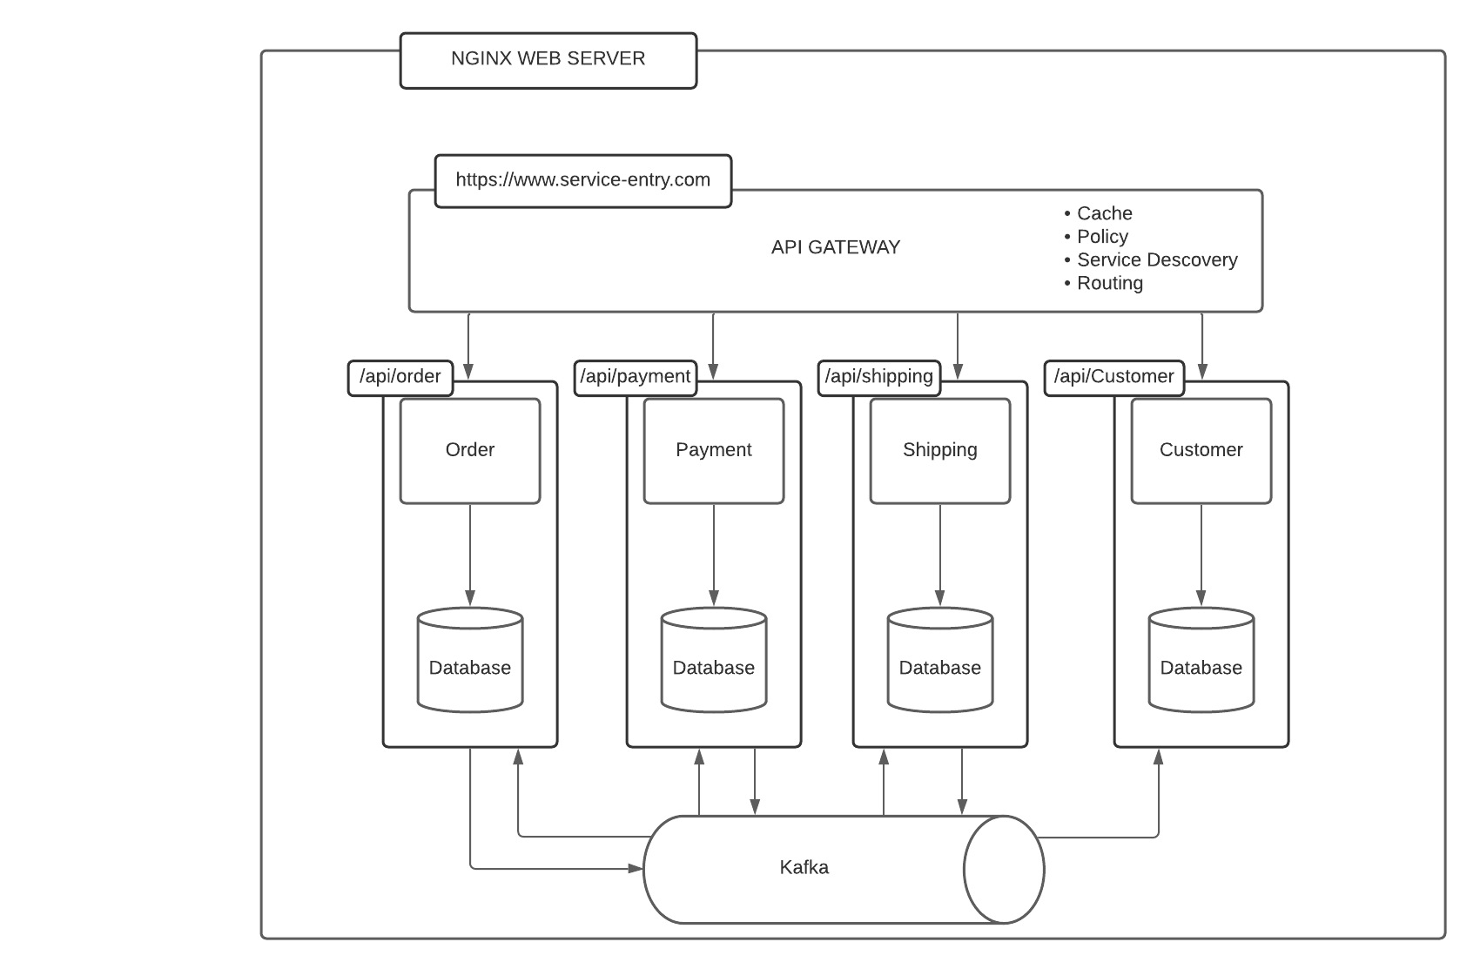
API Gateway
Route Request to backend services
Filter traffic on layer 7
Enforce Policies on request and response traffic
Transform incoming request and response
Expose a single point of entry
Elastic and scalable to meet demand and growth
API Management Services

Slide 12
Why use gRPC or Web Apis
gRPC is excellent for services to services call
gRPC is not for Web App Direct calls to a user interface
Restiful Web APIs act as entry point to gRPC
Restiful Web APIs are excellent for calls from user interface
gRPC is more secure and faster than Restiful APIs

Slide 13
Why Kafka?
Decoupling Services
Provides better scalability(growth over time) and elasticity (burst of request)
Provides a buffer to backend services
Backend services can scale or be trigger to scale in order to meet demand based on the amount of, incoming messages onto the messaging framework like Kafka

Slide 14

Web APIs

Slide 15
Restful web API design
Most modern web applications expose APIs that clients can use to interact with the application. A well-designed web API should aim to support:
Platform independence. Any client should be able to call the API, regardless of how the API is implemented internally. This requires using standard protocols, and having a mechanism whereby the client and the web service can agree on the format of the data to exchange.
Service evolution. The web API should be able to evolve and add functionality independently from client applications. As the API evolves, existing client applications should continue to function without modification. All functionality should be discoverable so that client applications can fully use it.
This guidance describes issues that you should consider when designing a web API.

Slide 16
What is REST?
In 2000, Roy Fielding proposed Representational State Transfer (REST) as an architectural approach to designing web services.
REST is an architectural style for building distributed systems based on hypermedia.
REST is independent of any underlying protocol and is not necessarily tied to HTTP.
However, most common REST API implementations use HTTP as the application protocol, and this guide focuses on designing REST APIs for HTTP.
A primary advantage of REST over HTTP is that it uses open standards, and does not bind the implementation of the API or the client applications to any specific implementation.
For example, a REST web service could be written in ASP.NET, and client applications can use any language or toolset that can generate HTTP requests and parse HTTP responses.

Slide 17
Main Design Principles of RESTful APIs using HTTP
REST APIs are designed around resources, which are any kind of object, data, or service that can be accessed by the client.
A resource has an identifier, which is a URI that uniquely identifies that resource. For example, the URI for a particular customer order might be:
https://adventure-works.com/orders/1

Slide 18
Main Design Principles of RESTful APIs using HTTP
Clients interact with a service by exchanging representations of resources.
Many web APIs use JSON as the exchange format.
For example, a GET request to the URI listed previously might return this response body:
{"orderId":1,"orderValue":99.90,"productId":1,"quantity":1}

Slide 19
Main Design Principles of RESTful APIs using HTTP
Clients interact with a service by exchanging representations of resources.
Many web APIs use JSON as the exchange format.
For example, a GET request to the URI listed previously might return this response body:
{"orderId":1,"orderValue":99.90,"productId":1,"quantity":1}

Slide 20
Main Design Principles of RESTful APIs using HTTP
REST APIs use a uniform interface, which helps to decouple the client and service implementations.
For REST APIs built on HTTP, the uniform interface includes using standard HTTP verbs to perform operations on resources.
The most common operations are GET, POST, PUT, PATCH, and DELETE.
REST APIs use a stateless request model. HTTP requests should be independent and may occur in any order, so keeping transient state information between requests is not feasible.
The only place where information is stored is in the resources themselves, and each request should be an atomic operation.

Slide 21
Main Design Principles of RESTful APIs using HTTP
This constraint enables web services to be highly scalable, because there is no need to retain any affinity between clients and specific servers.
Any server can handle any request from any client.
That said, other factors can limit scalability.
For example, many web services write to a backend data store, which may be hard to scale out.
For more information about strategies to scale out a data store, see Horizontal, vertical, and functional data partitioning.

Slide 22
Main Design Principles of RESTful APIs using HTTP
REST APIs are driven by hypermedia links that are contained in the representation.
For example, the following shows a JSON representation of an order.
It contains links to get or update the customer associated with the order.
{
"orderID":3,
"productID":2,
"quantity":4,
"orderValue":16.60,
"links": [
{"rel":"product","href":"https://adventure-works.com/customers/3", "action":"GET" },
{"rel":"product","href":"https://adventure-works.com/customers/3", "action":"PUT" }
]
}

Slide 23
Main Design Principles of RESTful APIs using HTTP
In 2008, Leonard Richardson proposed the following maturity model for web APIs:
Level 0: Define one URI, and all operations are POST requests to this URI.
Level 1: Create separate URIs for individual resources.
Level 2: Use HTTP methods to define operations on resources.
Level 3: Use hypermedia (HATEOAS, described below).
Level 3 corresponds to a truly RESTful API according to Fielding's definition. In practice, many published web APIs fall somewhere around level 2.

Slide 24
Organize the API Design Around Resources
Focus on the business entities that the web API exposes.
For example, in an e-commerce system, the primary entities might be customers and orders.
Creating an order can be achieved by sending an HTTP POST request that contains the order information.
The HTTP response indicates whether the order was placed successfully or not.
When possible, resource URIs should be based on nouns (the resource) and not verbs (the operations on the resource).
https://adventure-works.com/orders // Good
https://adventure-works.com/create-order // Avoid

Slide 25
Organize the API Design Around Resources
A resource doesn't have to be based on a single physical data item.
For example, an order resource might be implemented internally as several tables in a relational database, but presented to the client as a single entity.
Avoid creating APIs that simply mirror the internal structure of a database.
The purpose of REST is to model entities and the operations that an application can perform on those entities.
A client should not be exposed to the internal implementation.
Entities are often grouped together into collections (orders, customers).
A collection is a separate resource from the item within the collection, and should have its own URI. For example, the following URI might represent the collection of orders:
https://adventure-works.com/orders

Slide 26
Organize the API Design Around Resources
Sending an HTTP GET request to the collection URI retrieves a list of items in the collection.
Each item in the collection also has its own unique URI.
An HTTP GET request to the item's URI returns the details of that item.
Adopt a consistent naming convention in URIs. In general, it helps to use plural nouns for URIs that reference collections.
It's a good practice to organize URIs for collections and items into a hierarchy.
For example, /customers is the path to the customers collection, and /customers/5 is the path to the customer with ID equal to 5.
This approach helps to keep the web API intuitive. Also, many web API frameworks can route requests based on parameterized URI paths, so you could define a route for the path /customers/{id}.

Slide 27
Organize the API Design Around Resources
Also consider the relationships between different types of resources and how you might expose these associations.
For example, the /customers/5/orders might represent all of the orders for customer 5.
You could also go in the other direction, and represent the association from an order back to a customer with a URI such as /orders/99/customer.
However, extending this model too far can become cumbersome to implement.
A better solution is to provide navigable links to associated resources in the body of the HTTP response message.
This mechanism is described in more detail in the section Use HATEOAS to enable navigation to related resources.

Slide 28

Organize the API Design Around Resources
In more complex systems, it can be tempting to provide URIs that enable a client to navigate through several levels of relationships, such as /customers/1/orders/99/products.
However, this level of complexity can be difficult to maintain and is inflexible if the relationships between resources change in the future. Instead, try to keep URIs relatively simple.
Once an application has a reference to a resource, it should be possible to use this reference to find items related to that resource.
The preceding query can be replaced with the URI /customers/1/orders to find all the orders for customer 1, and then /orders/99/products to find the products in this order.
Tip
Avoid requiring resource URIs more complex than collection/item/collection.

Slide 29
Organize the API Design Around Resources
Another factor is that all web requests impose a load on the web server.
The more requests, the bigger the load. Therefore, try to avoid "chatty" web APIs that expose a large number of small resources.
Such an API may require a client application to send multiple requests to find all of the data that it requires.
Instead, you might want to denormalize the data and combine related information into bigger resources that can be retrieved with a single request.
However, you need to balance this approach against the overhead of fetching data that the client doesn't need.
Retrieving large objects can increase the latency of a request and incur additional bandwidth costs. For more information about these performance antipatterns, see Chatty I/O and Extraneous Fetching.

Slide 30
Organize the API Design Around Resources
Avoid introducing dependencies between the web API and the underlying data sources.
For example, if your data is stored in a relational database, the web API doesn't need to expose each table as a collection of resources. In fact, that's probably a poor design.
Instead, think of the web API as an abstraction of the database. If necessary, introduce a mapping layer between the database and the web API.
That way, client applications are isolated from changes to the underlying database scheme.

Slide 31
Organize the API Design Around Resources
Finally, it might not be possible to map every operation implemented by a web API to a specific resource.
You can handle such non-resource scenarios through HTTP requests that invoke a function and return the results as an HTTP response message.
For example, a web API that implements simple calculator operations such as add and subtract could provide URIs that expose these operations as pseudo resources and use the query string to specify the parameters required.
For example, a GET request to the URI /add?operand1=99&operand2=1 would return a response message with the body containing the value 100. However, only use these forms of URIs sparingly.

Slide 32
Define API operations in terms of HTTP methods
The HTTP protocol defines a number of methods that assign semantic meaning to a request. The common HTTP methods used by most RESTful web APIs are:
GET retrieves a representation of the resource at the specified URI. The body of the response message contains the details of the requested resource.
POST creates a new resource at the specified URI. The body of the request message provides the details of the new resource. Note that POST can also be used to trigger operations that don't actually create resources.
PUT either creates or replaces the resource at the specified URI. The body of the request message specifies the resource to be created or updated.
PATCH performs a partial update of a resource. The request body specifies the set of changes to apply to the resource.
DELETE removes the resource at the specified URI.

Slide 33
Define API operations in terms of HTTP methods
The effect of a specific request should depend on whether the resource is a collection or an individual item. The following table summarizes the common conventions adopted by most RESTful implementations using the e-commerce example. Not all of these requests might be implemented—it depends on the specific scenario.
Resource | POST | GET | PUT | DELETE
/customers | Create a new customer | Retrieve all customers | Bulk update of customers | Remove all customers
/customers/1 | Error | Retrieve the details for customer 1 | Update the details of customer 1 if it exists | Remove customer 1
/customers/1/orders | Create a new order for customer 1 | Retrieve all orders for customer 1 | Bulk update of orders for customer 1 | Remove all orders for customer 1

Slide 34
The differences between POST, PUT, and PATCH
The differences between POST, PUT, and PATCH can be confusing.
A POST request creates a resource.
The server assigns a URI for the new resource, and returns that URI to the client.
In the REST model, you frequently apply POST requests to collections.
The new resource is added to the collection.
A POST request can also be used to submit data for processing to an existing resource, without any new resource being created.

Slide 35
The differences between POST, PUT, and PATCH
A PUT request creates a resource or updates an existing resource.
The client specifies the URI for the resource.
The request body contains a complete representation of the resource.
If a resource with this URI already exists, it is replaced. Otherwise a new resource is created, if the server supports doing so.
PUT requests are most frequently applied to resources that are individual items, such as a specific customer, rather than collections.
A server might support updates but not creation via PUT.
Whether to support creation via PUT depends on whether the client can meaningfully assign a URI to a resource before it exists.
If not, then use POST to create resources and PUT or PATCH to update.

Slide 36
The differences between POST, PUT, and PATCH
The differences between POST, PUT, and PATCH can be confusing.
A PATCH request performs a partial update to an existing resource.
The client specifies the URI for the resource.
The request body specifies a set of changes to apply to the resource.
This can be more efficient than using PUT, because the client only sends the changes, not the entire representation of the resource.
Technically PATCH can also create a new resource (by specifying a set of updates to a "null" resource), if the server supports this.

Slide 37
The differences between POST, PUT, and PATCH
PUT requests must be idempotent.
If a client submits the same PUT request multiple times, the results should always be the same (the same resource will be modified with the same values).
POST and PATCH requests are not guaranteed to be idempotent.

Slide 38
Conform to HTTP semantics
This section describes some typical considerations for designing an API that conforms to the HTTP specification.
However, it doesn't cover every possible detail or scenario.
When in doubt, consult the HTTP specifications.

Slide 39
Media types
As mentioned earlier, clients and servers exchange representations of resources.
For example, in a POST request, the request body contains a representation of the resource to create.
In a GET request, the response body contains a representation of the fetched resource.
In the HTTP protocol, formats are specified through the use of media types, also called MIME types.
For non-binary data, most web APIs support JSON (media type = application/json) and possibly XML (media type = application/xml).

Slide 40
Media types
The Content-Type header in a request or response specifies the format of the representation. Here is an example of a POST request that includes JSON data:
If the server doesn't support the media type, it should return HTTP status code 415 (Unsupported Media Type).
POST https://adventure-works.com/orders HTTP/1.1
Content-Type: application/json; charset=utf-8
Content-Length: 57
{"Id":1,"Name":"Gizmo","Category":"Widgets","Price":1.99}

Slide 41
Media types
A client request can include an Accept header that contains a list of media types the client will accept from the server in the response message. For example:
If the server cannot match any of the media type(s) listed, it should return HTTP status code 406 (Not Acceptable).
GET https://adventure-works.com/orders/2 HTTP/1.1
Accept: application/json

Slide 42
GET methods
A successful GET method typically returns HTTP status code 200 (OK). If the resource cannot be found, the method should return 404 (Not Found).

Slide 43
POST methods
If a POST method creates a new resource, it returns HTTP status code 201 (Created). The URI of the new resource is included in the Location header of the response. The response body contains a representation of the resource.
If the method does some processing but does not create a new resource, the method can return HTTP status code 200 and include the result of the operation in the response body.
Alternatively, if there is no result to return, the method can return HTTP status code 204 (No Content) with no response body.
If the client puts invalid data into the request, the server should return HTTP status code 400 (Bad Request).
The response body can contain additional information about the error or a link to a URI that provides more details.

Slide 44
PATCH methods
With a PATCH request, the client sends a set of updates to an existing resource, in the form of a patch document.
The server processes the patch document to perform the update.
The patch document doesn't describe the whole resource, only a set of changes to apply.
The specification for the PATCH method (RFC 5789) doesn't define a particular format for patch documents.
The format must be inferred from the media type in the request.
JSON is probably the most common data format for web APIs.
There are two main JSON-based patch formats, called JSON patch and JSON merge patch.

Slide 45
PATCH methods
JSON merge patch is somewhat simpler.
The patch document has the same structure as the original JSON resource, but includes just the subset of fields that should be changed or added.
In addition, a field can be deleted by specifying null for the field value in the patch document.
(That means merge patch is not suitable if the original resource can have explicit null values.)
For example, suppose the original resource has the following JSON representation:
{
"name":"gizmo",
"category":"widgets",
"color":"blue",
"price":10
}

Slide 46
PATCH methods
JSON merge patch is somewhat simpler.
The patch document has the same structure as the original JSON resource, but includes just the subset of fields that should be changed or added.
In addition, a field can be deleted by specifying null for the field value in the patch document. (That means merge patch is not suitable if the original resource can have explicit null values.)
For example, suppose the original resource has the following JSON representation:
{
"name":"gizmo",
"category":"widgets",
"color":"blue",
"price":10
}
Here is a possible JSON merge patch for this resource:
{
"price":12,
"color":null,
"size":"small"
}
This tells the server to update price, delete color, and add size, while name and category are not modified. For the exact details of JSON merge patch, see RFC 7396. The media type for JSON merge patch is application/merge-patch+json.

Slide 47
PATCH methods
Merge patch is not suitable if the original resource can contain explicit null values, due to the special meaning of null in the patch document.
Also, the patch document doesn't specify the order that the server should apply the updates. That may or may not matter, depending on the data and the domain.
JSON patch, defined in RFC 6902, is more flexible.
It specifies the changes as a sequence of operations to apply.
Operations include add, remove, replace, copy, and test (to validate values).
The media type for JSON patch is application/json-patch+json.

Slide 48
PATCH methods
Here are some typical error conditions that might be encountered when processing a PATCH request, along with the appropriate HTTP status code.
Error condition | HTTP status code
The patch document format isn't supported. | 415 (Unsupported Media Type)
Malformed patch document. | 400 (Bad Request)
The patch document is valid, but the changes can't be applied to the resource in its current state. | 409 (Conflict)

Slide 49
DELETE methods
If the delete operation is successful, the web server should respond with HTTP status code 204 (No Content), indicating that the process has been successfully handled, but that the response body contains no further information.
If the resource doesn't exist, the web server can return HTTP 404 (Not Found).

Slide 50
Asynchronous operations
Sometimes a POST, PUT, PATCH, or DELETE operation might require processing that takes a while to complete.
If you wait for completion before sending a response to the client, it may cause unacceptable latency.
If so, consider making the operation asynchronous.
Return HTTP status code 202 (Accepted) to indicate the request was accepted for processing but is not completed.
You should expose an endpoint that returns the status of an asynchronous request, so the client can monitor the status by polling the status endpoint.
Include the URI of the status endpoint in the Location header of the 202 response. For example:
HTTP/1.1 202 Accepted
Location: /api/status/12345

Slide 51
Asynchronous operations
If the client sends a GET request to this endpoint, the response should contain the current status of the request. Optionally, it could also include an estimated time to completion or a link to cancel the operation.
If the asynchronous operation creates a new resource, the status endpoint should return status code 303 (See Other) after the operation completes. In the 303 response, include a Location header that gives the URI of the new resource:
HTTP/1.1 200 OK
Content-Type: application/json
{
"status":"In progress",
"link": { "rel":"cancel", "method":"delete", "href":"/api/status/12345" }
}
HTTP/1.1 303 See Other
Location: /api/orders/12345
Asynchronous Request-Reply pattern.

Slide 52
Filter and paginate data
Exposing a collection of resources through a single URI can lead to applications fetching large amounts of data when only a subset of the information is required.
For example, suppose a client application needs to find all orders with a cost over a specific value.
It might retrieve all orders from the /orders URI and then filter these orders on the client side.
Clearly this process is highly inefficient. It wastes network bandwidth and processing power on the server hosting the web API.
Instead, the API can allow passing a filter in the query string of the URI, such as /orders?minCost=n.
The web API is then responsible for parsing and handling the minCost parameter in the query string and returning the filtered results on the server side.

Slide 53
Filter and paginate data
GET requests over collection resources can potentially return a large number of items.
You should design a web API to limit the amount of data returned by any single request.
Consider supporting query strings that specify the maximum number of items to retrieve and a starting offset into the collection. For example:
/orders?limit=25&offset=50

Slide 54
Filter and paginate data
Also consider imposing an upper limit on the number of items returned, to help prevent Denial of Service attacks.
To assist client applications, GET requests that return paginated data should also include some form of metadata that indicate the total number of resources available in the collection.
You can use a similar strategy to sort data as it is fetched, by providing a sort parameter that takes a field name as the value, such as /orders?sort=ProductID.
However, this approach can have a negative effect on caching, because query string parameters form part of the resource identifier used by many cache implementations as the key to cached data.
You can extend this approach to limit the fields returned for each item, if each item contains a large amount of data.
For example, you could use a query string parameter that accepts a comma-delimited list of fields, such as /orders?fields=ProductID,Quantity.

Slide 55
Filter and paginate data
Give all optional parameters in query strings meaningful defaults.
For example, set the limit parameter to 10 and the offset parameter to 0 if you implement pagination, set the sort parameter to the key of the resource if you implement ordering, and set the fields parameter to all fields in the resource if you support projections.

Slide 56
Support partial responses for large binary resources
A resource may contain large binary fields, such as files or images.
To overcome problems caused by unreliable and intermittent connections and to improve response times, consider enabling such resources to be retrieved in chunks.
To do this, the web API should support the Accept-Ranges header for GET requests for large resources.
This header indicates that the GET operation supports partial requests.
The client application can submit GET requests that return a subset of a resource, specified as a range of bytes.

Slide 57
Support partial responses for large binary resources
Also, consider implementing HTTP HEAD requests for these resources.
A HEAD request is similar to a GET request, except that it only returns the HTTP headers that describe the resource, with an empty message body.
A client application can issue a HEAD request to determine whether to fetch a resource by using partial GET requests. For example:
Here is an example response message:
HEAD https://adventure-works.com/products/10?fields=productImage HTTP/1.1
HTTP/1.1 200 OK
Accept-Ranges: bytes
Content-Type: image/jpeg
Content-Length: 4580

Slide 58
Support partial responses for large binary resources
The Content-Length header gives the total size of the resource, and the Accept-Ranges header indicates that the corresponding GET operation supports partial results.
The client application can use this information to retrieve the image in smaller chunks.
The first request fetches the first 2500 bytes by using the Range header:
HEAD https://adventure-works.com/products/10?fields=productImage HTTP/1.1
Range: bytes=0-2499

Slide 59
Support partial responses for large binary resources
The response message indicates that this is a partial response by returning HTTP status code 206.
The Content-Length header specifies the actual number of bytes returned in the message body (not the size of the resource), and the Content-Range header indicates which part of the resource this is (bytes 0-2499 out of 4580):
A subsequent request from the client application can retrieve the remainder of the resource.
HTTP/1.1 206 Partial Content
Accept-Ranges: bytes
Content-Type: image/jpeg
Content-Length: 2500
Content-Range: bytes 0-2499/4580
[...]

Slide 60

Use HATEOAS to enable navigation to related resources
One of the primary motivations behind REST is that it should be possible to navigate the entire set of resources without requiring prior knowledge of the URI scheme.
Each HTTP GET request should return the information necessary to find the resources related directly to the requested object through hyperlinks included in the response, and it should also be provided with information that describes the operations available on each of these resources.
This principle is known as HATEOAS, or Hypertext as the Engine of Application State.
The system is effectively a finite state machine, and the response to each request contains the information necessary to move from one state to another; no other information should be necessary.
Note
Currently there are no general-purpose standards that define how to model the HATEOAS principle. The examples shown in this section illustrate one possible, proprietary solution.

Slide 61
Use HATEOAS to enable navigation to related resources
For example, to handle the relationship between an order and a customer, the representation of an order could include links that identify the available operations for the customer of the order.
Here is a possible representation:
{
"orderID":3,
"productID":2,
"quantity":4,
"orderValue":16.60,
"links":[
{
"rel":"customer",
"href":"https://adventure-works.com/customers/3",
"action":"GET",
"types":["text/xml","application/json"]
},
{
"rel":"customer",
"href":"https://adventure-works.com/customers/3",
"action":"PUT",
"types":["application/x-www-form-urlencoded"]
},
{
"rel":"customer",
"href":"https://adventure-works.com/customers/3",
"action":"DELETE",
"types":[]
},
{
"rel":"self",
"href":"https://adventure-works.com/orders/3",
"action":"GET",
"types":["text/xml","application/json"]
},
{
"rel":"self",
"href":"https://adventure-works.com/orders/3",
"action":"PUT",
"types":["application/x-www-form-urlencoded"]
},
{
"rel":"self",
"href":"https://adventure-works.com/orders/3",
"action":"DELETE",
"types":[]
}]
}

Slide 62
Use HATEOAS to enable navigation to related resources
In the previous example, the links array has a set of links.
Each link represents an operation on a related entity.
The data for each link includes the relationship ("customer"), the URI (https://adventure-works.com/customers/3), the HTTP method, and the supported MIME types.
This is all the information that a client application needs to be able to invoke the operation.
The links array also includes self-referencing information about the resource itself that has been retrieved.
These have the relationship self.
The set of links that are returned may change, depending on the state of the resource.
This is what is meant by hypertext being the "engine of application state."

Slide 63
Versioning a RESTful web API
It is highly unlikely that a web API will remain static.
As business requirements change new collections of resources may be added, the relationships between resources might change, and the structure of the data in resources might be amended.
While updating a web API to handle new or differing requirements is a relatively straightforward process, you must consider the effects that such changes will have on client applications consuming the web API.
The issue is that although the developer designing and implementing a web API has full control over that API, the developer does not have the same degree of control over client applications, which may be built by third-party organizations operating remotely.
The primary imperative is to enable existing client applications to continue functioning unchanged while allowing new client applications to take advantage of new features and resources.

Slide 64
Versioning a RESTful web API
Versioning enables a web API to indicate the features and resources that it exposes, and a client application can submit requests that are directed to a specific version of a feature or resource.
The following sections describe several different approaches, each of which has its own benefits and trade-offs.

Slide 65

No versioning
This is the simplest approach, and may be acceptable for some internal APIs.
Significant changes could be represented as new resources or new links.
Adding content to existing resources might not present a breaking change as client applications that are not expecting to see this content will ignore it.
For example, a request to the URI https://adventure-works.com/customers/3 should return the details of a single customer containing id, name, and address fields expected by the client application:
HTTP/1.1 200 OK
Content-Type: application/json; charset=utf-8
{"id":3,"name":"Contoso LLC","address":"1 Microsoft Way Redmond WA 98053"}
Note: For simplicity, the example responses shown in this section do not include HATEOAS links.

Slide 66
No versioning
If the DateCreated field is added to the schema of the customer resource, then the response would look like this:
Existing client applications might continue functioning correctly if they are capable of ignoring unrecognized fields, while new client applications can be designed to handle this new field.
However, if more radical changes to the schema of resources occur (such as removing or renaming fields) or the relationships between resources change then these may constitute breaking changes that prevent existing client applications from functioning correctly.
In these situations, you should consider one of the following approaches.
HTTP/1.1 200 OK
Content-Type: application/json; charset=utf-8
{"id":3,"name":"Contoso LLC","dateCreated":"2014-09-04T12:11:38.0376089Z","address":"1 Microsoft Way Redmond WA 98053"}

Slide 67
URI versioning
Each time you modify the web API or change the schema of resources, you add a version number to the URI for each resource.
The previously existing URIs should continue to operate as before, returning resources that conform to their original schema.
Extending the previous example, if the address field is restructured into subfields containing each constituent part of the address (such as streetAddress, city, state, and zipCode), this version of the resource could be exposed through a URI containing a version number, such as https://adventure-works.com/v2/customers/3:
HTTP/1.1 200 OK
Content-Type: application/json; charset=utf-8
{"id":3,"name":"Contoso LLC","dateCreated":"2014-09-04T12:11:38.0376089Z","address":{"streetAddress":"1 Microsoft Way","city":"Redmond","state":"WA","zipCode":98053}}

Slide 68
URI versioning
This versioning mechanism is very simple but depends on the server routing the request to the appropriate endpoint.
However, it can become unwieldy as the web API matures through several iterations and the server has to support a number of different versions.
Also, from a purist's point of view, in all cases the client applications are fetching the same data (customer 3), so the URI should not really be different depending on the version.
This scheme also complicates implementation of HATEOAS as all links will need to include the version number in their URIs.

Slide 69
Query string versioning
Rather than providing multiple URIs, you can specify the version of the resource by using a parameter within the query string appended to the HTTP request, such as https://adventure-works.com/customers/3?version=2.
The version parameter should default to a meaningful value such as 1 if it is omitted by older client applications.
This approach has the semantic advantage that the same resource is always retrieved from the same URI, but it depends on the code that handles the request to parse the query string and send back the appropriate HTTP response.
This approach also suffers from the same complications for implementing HATEOAS as the URI versioning

Slide 70
Header versioning
Rather than appending the version number as a query string parameter, you could implement a custom header that indicates the version of the resource.
This approach requires that the client application adds the appropriate header to any requests, although the code handling the client request could use a default value (version 1) if the version header is omitted.
The following examples use a custom header named Custom-Header. The value of this header indicates the version of web API.
As with the previous two approaches, implementing HATEOAS requires including the appropriate custom header in any links.
Version 1:
Version 2:
GET https://adventure-works.com/customers/3 HTTP/1.1
Custom-Header: api-version=1
GET https://adventure-works.com/customers/3 HTTP/1.1
Custom-Header: api-version=2
HTTP/1.1 200 OK
Content-Type: application/json; charset=utf-8
{"id":3,"name":"Contoso LLC","address":"1 Microsoft Way Redmond WA 98053"}
HTTP/1.1 200 OK
Content-Type: application/json; charset=utf-8
{"id":3,"name":"Contoso LLC","dateCreated":"2014-09-04T12:11:38.0376089Z","address":{"streetAddress":"1 Microsoft Way","city":"Redmond","state":"WA","zipCode":98053}}

Slide 71
Media type versioning
When a client application sends an HTTP GET request to a web server it should stipulate the format of the content that it can handle by using an Accept header, as described earlier in this guidance.
Frequently the purpose of the Accept header is to allow the client application to specify whether the body of the response should be XML, JSON, or some other common format that the client can parse.
However, it is possible to define custom media types that include information enabling the client application to indicate which version of a resource it is expecting.
The following example shows a request that specifies an Accept header with the value application/vnd.adventure-works.v1+json.
The vnd.adventure-works.v1 element indicates to the web server that it should return version 1 of the resource, while the json element specifies that the format of the response body should be JSON:
GET https://adventure-works.com/customers/3 HTTP/1.1
Accept: application/vnd.adventure-works.v1+json

Slide 72
Media type versioning
The code handling the request is responsible for processing the Accept header and honoring it as far as possible (the client application may specify multiple formats in the Accept header, in which case the web server can choose the most appropriate format for the response body).
The web server confirms the format of the data in the response body by using the Content-Type header:
If the Accept header does not specify any known media types, the web server could generate an HTTP 406 (Not Acceptable) response message or return a message with a default media type.
This approach is arguably the purest of the versioning mechanisms and lends itself naturally to HATEOAS, which can include the MIME type of related data in resource links.
HTTP/1.1 200 OK
Content-Type: application/vnd.adventure-works.v1+json; charset=utf-8
{"id":3,"name":"Contoso LLC","address":"1 Microsoft Way Redmond WA 98053"}

Slide 73
Implications on Performance
When you select a versioning strategy, you should also consider the implications on performance, especially caching on the web server.
The URI versioning and Query String versioning schemes are cache-friendly inasmuch as the same URI/query string combination refers to the same data each time.
The Header versioning and Media Type versioning mechanisms typically require additional logic to examine the values in the custom header or the Accept header.
In a large-scale environment, many clients using different versions of a web API can result in a significant amount of duplicated data in a server-side cache.
This issue can become acute if a client application communicates with a web server through a proxy that implements caching, and that only forwards a request to the web server if it does not currently hold a copy of the requested data in its cache.

Slide 74
Open API Initiative
The Open API Initiative was created by an industry consortium to standardize REST API descriptions across vendors. As part of this initiative, the Swagger 2.0 specification was renamed the OpenAPI Specification (OAS) and brought under the Open API Initiative.
You may want to adopt OpenAPI for your web APIs. Some points to consider:
The OpenAPI Specification comes with a set of opinionated guidelines on how a REST API should be designed. That has advantages for interoperability, but requires more care when designing your API to conform to the specification.
OpenAPI promotes a contract-first approach, rather than an implementation-first approach. Contract-first means you design the API contract (the interface) first and then write code that implements the contract.
Tools like Swagger can generate client libraries or documentation from API contracts.

Slide 75
Summary
What is Rest?
Define API operations
Conform to Http semantics
Filter and Pagination
Support partial responses for large responses
HATEOAS
Versioning
Open API Initiative
Additional Reading Api Implementation Best Practices

Slide 76

gRPC Client/Server

Slide 77
Intro to gRPC
gRPC is a language agnostic, high-performance Remote Procedure Call (RPC) framework.
The main benefits of gRPC are:
Modern, high-performance, lightweight RPC framework.
Contract-first API development, using Protocol Buffers by default, allowing for language agnostic implementations.
Tooling available for many languages to generate strongly-typed servers and clients.
Supports client, server, and bi-directional streaming calls.
Reduced network usage with Protobuf binary serialization.
These benefits make gRPC ideal for:
Lightweight microservices where efficiency is critical.
Polyglot systems where multiple languages are required for development.
Point-to-point real-time services that need to handle streaming requests or responses.

Slide 78
C# Tooling support for .proto files
gRPC uses a contract-first approach to API development. Services and messages are defined in *.proto files:
syntax = "proto3";
service Greeter {
rpc SayHello (HelloRequest) returns (HelloReply);
}
message HelloRequest {
string name = 1;
}
message HelloReply {
string message = 1;
}

Slide 79
C# Tooling support for .proto files
.NET types for services, clients, and messages are automatically generated by including *.proto files in a project:
Add a package reference to Grpc.Tools package.
Add *.proto files to the <Protobuf> item group.
<ItemGroup>
<Protobuf Include="Protos\greet.proto" />
</ItemGroup>

Slide 80
gRPC services on ASP.NET Core
gRPC services can be hosted on ASP.NET Core. Services have full integration with ASP.NET Core features such as logging, dependency injection (DI), authentication, and authorization.
Add gRPC services to an ASP.NET Core app
gRPC requires the Grpc.AspNetCore package. For information on configuring gRPC in a .NET app, see Configure gRPC.

Slide 81
The gRPC service project template
The gRPC service project template provides a starter service:
public class GreeterService : Greeter.GreeterBase
{
private readonly ILogger<GreeterService> _logger;
public GreeterService(ILogger<GreeterService> logger)
{
_logger = logger;
}
public override Task<HelloReply> SayHello(HelloRequest request,
ServerCallContext context)
{
_logger.LogInformation("Saying hello to {Name}", request.Name);
return Task.FromResult(new HelloReply
{
Message = "Hello " + request.Name
});
}
}

Slide 82
Endpoints Routing
GreeterService inherits from the GreeterBase type, which is generated from the Greeter service in the *.proto file. The service is made accessible to clients in Startup.cs:
app.UseEndpoints(endpoints =>
{
endpoints.MapGrpcService<GreeterService>();
});

Slide 83
Create new gRPC services
gRPC services with C# introduced gRPC's contract-first approach to API development. Services and messages are defined in .proto files. C# tooling then generates code from .proto files. For server-side assets, an abstract base type is generated for each service, along with classes for any messages.
The following .proto file:
Defines a Greeter service.
The Greeter service defines a SayHello call.
SayHello sends a HelloRequest message and receives a HelloReply message
syntax = "proto3";
service Greeter {
rpc SayHello (HelloRequest) returns (HelloReply);
}
message HelloRequest {
string name = 1;
}
message HelloReply {
string message = 1;
}

Slide 84
Create new gRPC services
C# tooling generates the C# GreeterBase base type:
public abstract partial class GreeterBase
{
public virtual Task<HelloReply> SayHello(HelloRequest request, ServerCallContext context)
{
throw new RpcException(new Status(StatusCode.Unimplemented, ""));
}
}
public class HelloRequest
{
public string Name { get; set; }
}
public class HelloReply
{
public string Message { get; set; }
}

Slide 85
Create new gRPC services
By default the generated GreeterBase doesn't do anything. Its virtual SayHello method will return an UNIMPLEMENTED error to any clients that call it. For the service to be useful an app must create a concrete implementation of GreeterBase:
public class GreeterService : GreeterBase
{
public override Task<HelloReply> SayHello(HelloRequest request, ServerCallContext context)
{
return Task.FromResult(new HelloReply { Message = $"Hello {request.Name}" });
}
}

Slide 86
Create new gRPC services
The ServerCallContext gives the context for a server-side call.
The service implementation is registered with the app. If the service is hosted by ASP.NET Core gRPC, it should be added to the routing pipeline with the MapGrpcService method
app.UseEndpoints(endpoints =>
{
endpoints.MapGrpcService<GreeterService>();
});

Slide 87
Implement gRPC methods
A gRPC service can have different types of methods. How messages are sent and received by a service depends on the type of method defined. The gRPC method types are:
Unary
Server streaming
Client streaming
Bi-directional streaming
Streaming calls are specified with the stream keyword in the .proto file. stream can be placed on a call's request message, response message, or both.
Each call type has a different method signature. Overriding generated methods from the abstract base service type in a concrete implementation ensures the correct arguments and return type are used.
syntax = "proto3";
service ExampleService {
// Unary
rpc UnaryCall (ExampleRequest) returns (ExampleResponse);
// Server streaming
rpc StreamingFromServer (ExampleRequest) returns (stream ExampleResponse);
// Client streaming
rpc StreamingFromClient (stream ExampleRequest) returns (ExampleResponse);
// Bi-directional streaming
rpc StreamingBothWays (stream ExampleRequest) returns (stream ExampleResponse);
}

Slide 88
Unary method
A unary method gets the request message as a parameter, and returns the response.
A unary call is complete when the response is returned.
public override Task<ExampleResponse> UnaryCall(ExampleRequest request,
ServerCallContext context)
{
var response = new ExampleResponse();
return Task.FromResult(response);
}

Slide 89
Unary method
Unary calls are the most similar to actions on web API controllers.
One important difference gRPC methods have from actions is gRPC methods are not able to bind parts of a request to different method arguments.
gRPC methods always have one message argument for the incoming request data. Multiple values can still be sent to a gRPC service by making them fields on the request message:
message ExampleRequest {
int32 pageIndex = 1;
int32 pageSize = 2;
bool isDescending = 3;
}

Slide 90
Server streaming method
A server streaming method gets the request message as a parameter.
Because multiple messages can be streamed back to the caller, responseStream.WriteAsync is used to send response messages.
A server streaming call is complete when the method returns.
public override async Task StreamingFromServer(ExampleRequest request,
IServerStreamWriter<ExampleResponse> responseStream, ServerCallContext context)
{
for (var i = 0; i < 5; i++)
{
await responseStream.WriteAsync(new ExampleResponse());
await Task.Delay(TimeSpan.FromSeconds(1));
}
}

Slide 91
Server streaming method
The client has no way to send additional messages or data once the server streaming method has started.
Some streaming methods are designed to run forever.
For continuous streaming methods, a client can cancel the call when it's no longer needed.
When cancellation happens the client sends a signal to the server and the ServerCallContext.CancellationToken is raised.
The CancellationToken token should be used on the server with async methods so that:
Any asynchronous work is canceled together with the streaming call.
The method exits quickly.
public override async Task StreamingFromServer(ExampleRequest request,
IServerStreamWriter<ExampleResponse> responseStream, ServerCallContext context)
{
while (!context.CancellationToken.IsCancellationRequested)
{
await responseStream.WriteAsync(new ExampleResponse());
await Task.Delay(TimeSpan.FromSeconds(1), context.CancellationToken);
}
}

Slide 92
Client streaming method
A client streaming method starts without the method receiving a message.
The requestStream parameter is used to read messages from the client.
A client streaming call is complete when a response message is returned:
public override async Task<ExampleResponse> StreamingFromClient(
IAsyncStreamReader<ExampleRequest> requestStream, ServerCallContext context)
{
while (await requestStream.MoveNext())
{
var message = requestStream.Current;
// ...
}
return new ExampleResponse();
}

Slide 93
Client streaming method
When using C# 8 or later, the await foreach syntax can be used to read messages.
The IAsyncStreamReader<T>.ReadAllAsync() extension method reads all messages from the request stream:
public override async Task<ExampleResponse> StreamingFromClient(
IAsyncStreamReader<ExampleRequest> requestStream, ServerCallContext context)
{
await foreach (var message in requestStream.ReadAllAsync())
{
// ...
}
return new ExampleResponse();
}

Slide 94
Bi-directional streaming method
A bi-directional streaming method starts without the method receiving a message.
The requestStream parameter is used to read messages from the client.
The method can choose to send messages with responseStream.WriteAsync.
A bi-directional streaming call is complete when the method returns:
The provided code:
Sends a response for each request.
Is a basic usage of bi-directional streaming.
public override async Task StreamingBothWays(IAsyncStreamReader<ExampleRequest>
requestStream, IServerStreamWriter<ExampleResponse> responseStream,
ServerCallContext context)
{
await foreach (var message in requestStream.ReadAllAsync())
{
await responseStream.WriteAsync(new ExampleResponse());
}
}

Slide 95
Bi-directional streaming method
It is possible to support more complex scenarios, such as reading requests and sending responses simultaneously:
In a bi-directional streaming method, the client and service can send messages to each other at any time.
The best implementation of a bi-directional method varies depending upon requirements.
public override async Task StreamingBothWays(IAsyncStreamReader<ExampleRequest> requestStream,
IServerStreamWriter<ExampleResponse> responseStream, ServerCallContext context)
{
// Read requests in a background task.
var readTask = Task.Run(async () =>
{
await foreach (var message in requestStream.ReadAllAsync())
{
// Process request.
}
});
// Send responses until the client signals that it is complete.
while (!readTask.IsCompleted)
{
await responseStream.WriteAsync(new ExampleResponse());
await Task.Delay(TimeSpan.FromSeconds(1), context.CancellationToken);
}
}

Slide 96
Access gRPC request headers
A request message is not the only way for a client to send data to a gRPC service. Header values are available in a service using ServerCallContext.RequestHeaders.
public override Task<ExampleResponse> UnaryCall(ExampleRequest request, ServerCallContext context)
{
var userAgent = context.RequestHeaders.GetValue("user-agent");
// ...
return Task.FromResult(new ExampleResponse());
}

Slide 97
Call gRPC services with a .NET client
gRPC clients are concrete client types that are generated from *.proto files. The concrete gRPC client has methods that translate to the gRPC service in the *.proto file.
A gRPC client is created using a channel, which represents a long-lived connection to a gRPC service. A channel can be created using GrpcChannel.ForAddress.
var channel = GrpcChannel.ForAddress("https://localhost:5001");
var client = new Greeter.GreeterClient(channel);
var response = await client.SayHelloAsync(new HelloRequest { Name = "World" });
Console.WriteLine(response.Message);

Slide 98
Configure gRPC client
A channel represents a long-lived connection to a gRPC service.
When a channel is created, it's configured with options related to calling a service.
For example, the HttpClient used to make calls, the maximum send and receive message size, and logging can be specified on GrpcChannelOptions and used with GrpcChannel.ForAddress.
For a complete list of options, see client configuration options.

Slide 99
Configure services options
Option | Default Value | Description
MaxSendMessageSize | null | The maximum message size in bytes that can be sent from the server. Attempting to send a message that exceeds the configured maximum message size results in an exception. When set to null, the message size is unlimited.
MaxReceiveMessageSize | 4 MB | The maximum message size in bytes that can be received by the server. If the server receives a message that exceeds this limit, it throws an exception. Increasing this value allows the server to receive larger messages, but can negatively impact memory consumption. When set to null, the message size is unlimited.
EnableDetailedErrors | false | If true, detailed exception messages are returned to clients when an exception is thrown in a service method. The default is false. Setting EnableDetailedErrors to true can leak sensitive information.
CompressionProviders | gzip | A collection of compression providers used to compress and decompress messages. Custom compression providers can be created and added to the collection. The default configured providers support gzip compression.
ResponseCompressionAlgorithm | null | The compression algorithm used to compress messages sent from the server. The algorithm must match a compression provider in CompressionProviders. For the algorithm to compress a response, the client must indicate it supports the algorithm by sending it in the grpc-accept-encoding header.
ResponseCompressionLevel | null | The compress level used to compress messages sent from the server.
Interceptors | None | A collection of interceptors that are run with each gRPC call. Interceptors are run in the order they are registered. Globally configured interceptors are run before interceptors configured for a single service. For more information about gRPC interceptors, see gRPC Interceptors vs. Middleware.
IgnoreUnknownServices | false | If true, calls to unknown services and methods don't return an UNIMPLEMENTED status, and the request passes to the next registered middleware in ASP.NET Core.

Slide 100
Configure services options
Options can be configured for all services by providing an options delegate to the AddGrpc call in Startup.ConfigureServices:
Options for a single service override the global options provided in AddGrpc and can be configured using AddServiceOptions<TService>:
public void ConfigureServices(IServiceCollection services)
{
services.AddGrpc(options =>
{
options.EnableDetailedErrors = true;
options.MaxReceiveMessageSize = 2 * 1024 * 1024; // 2 MB
options.MaxSendMessageSize = 5 * 1024 * 1024; // 5 MB
});
}
public void ConfigureServices(IServiceCollection services)
{
services.AddGrpc().AddServiceOptions<MyService>(options =>
{
options.MaxReceiveMessageSize = 2 * 1024 * 1024; // 2 MB
options.MaxSendMessageSize = 5 * 1024 * 1024; // 5 MB
});
}

Slide 101
Configure client options
Option | Default Value | Description
HttpHandler | New instance | The HttpMessageHandler used to make gRPC calls. A client can be set to configure a custom HttpClientHandler or add additional handlers to the HTTP pipeline for gRPC calls. If no HttpMessageHandler is specified, a new HttpClientHandler instance is created for the channel with automatic disposal.
HttpClient | null | The HttpClient used to make gRPC calls. This setting is an alternative to HttpHandler.
DisposeHttpClient | false | If set to true and an HttpMessageHandler or HttpClient is specified, then either the HttpHandler or HttpClient, respectively, is disposed when the GrpcChannel is disposed.
LoggerFactory | null | The LoggerFactory used by the client to log information about gRPC calls. A LoggerFactory instance can be resolved from dependency injection or created using LoggerFactory.Create. For examples of configuring logging, see Logging and diagnostics in gRPC on .NET.
MaxSendMessageSize | null | The maximum message size in bytes that can be sent from the client. Attempting to send a message that exceeds the configured maximum message size results in an exception. When set to null, the message size is unlimited.
MaxReceiveMessageSize | 4 MB | The maximum message size in bytes that can be received by the client. If the client receives a message that exceeds this limit, it throws an exception. Increasing this value allows the client to receive larger messages, but can negatively impact memory consumption. When set to null, the message size is unlimited.
Credentials | null | A ChannelCredentials instance. Credentials are used to add authentication metadata to gRPC calls.

Slide 102
Configure client options
Option | Default Value | Description
CompressionProviders | gzip | A collection of compression providers used to compress and decompress messages. Custom compression providers can be created and added to the collection. The default configured providers support gzip compression.
ThrowOperationCanceledOnCancellation | false | If set to true, clients throw OperationCanceledException when a call is canceled or its deadline is exceeded.
MaxRetryAttempts | 5 | The maximum retry attempts. This value limits any retry and hedging attempt values specified in the service config. Setting this value alone doesn't enable retries. Retries are enabled in the service config, which can be done using ServiceConfig. A null value removes the maximum retry attempts limit. For more information about retries, see Transient fault handling with gRPC retries.
MaxRetryBufferSize | 16 MB | The maximum buffer size in bytes that can be used to store sent messages when retrying or hedging calls. If the buffer limit is exceeded, then no more retry attempts are made and all hedging calls but one will be canceled. This limit is applied across all calls made using the channel. A null value removes the maximum retry buffer size limit.
MaxRetryBufferPerCallSize | 1 MB | The maximum buffer size in bytes that can be used to store sent messages when retrying or hedging calls. If the buffer limit is exceeded, then no more retry attempts are made and all hedging calls but one will be canceled. This limit is applied to one call. A null value removes the maximum retry buffer size limit per call.
ServiceConfig | null | The service config for a gRPC channel. A service config can be used to configure gRPC retries.

Slide 103
Configure client options
The following code:
Sets the maximum send and receive message size on the channel.
Creates a client.
static async Task Main(string[] args)
{
var channel = GrpcChannel.ForAddress("https://localhost:5001", new GrpcChannelOptions
{
MaxReceiveMessageSize = 5 * 1024 * 1024, // 5 MB
MaxSendMessageSize = 2 * 1024 * 1024 // 2 MB
});
var client = new Greeter.GreeterClient(channel);
var reply = await client.SayHelloAsync(
new HelloRequest { Name = "GreeterClient" });
Console.WriteLine("Greeting: " + reply.Message);
}

Slide 104
Configure TLS
A gRPC client must use the same connection-level security as the called service.
gRPC client Transport Layer Security (TLS) is configured when the gRPC channel is created.
A gRPC client throws an error when it calls a service and the connection-level security of the channel and service don't match.
To configure a gRPC channel to use TLS, ensure the server address starts with https. For example, GrpcChannel.ForAddress("https://localhost:5001") uses HTTPS protocol.
The gRPC channel automatically negotiates a connection secured by TLS and uses a secure connection to make gRPC calls.
To call unsecured gRPC services, ensure the server address starts with http.

Slide 105

Kafka Intergration

Slide 106
What Is Apache Kafka?
Apache Kafka is an event streaming platform used to collect, process, store, and integrate data at scale.
It has numerous use cases including distributed logging, stream processing, data integration, and pub/sub messaging.
In order to make complete sense of what Kafka does, we'll delve into what an "event streaming platform" is and how it works.
So before delving into Kafka architecture or its core components, let's discuss what an event is.
This will help explain how Kafka stores events, how to get events in and out of the system, and how to analyze event streams.

Slide 107
What Are Events?
An event is any type of action, incident, or change that's identified or recorded by software or applications.
For example, a payment, a website click, or a temperature reading, along with a description of what happened.
In other words, an event is a combination of notification—the element of when-ness that can be used to trigger some other activity—and state.
That state is usually fairly small, say less than a megabyte or so, and is normally represented in some structured format, say in JSON or an object serialized with Apache Avro™ or Protocol Buffers.

Slide 108
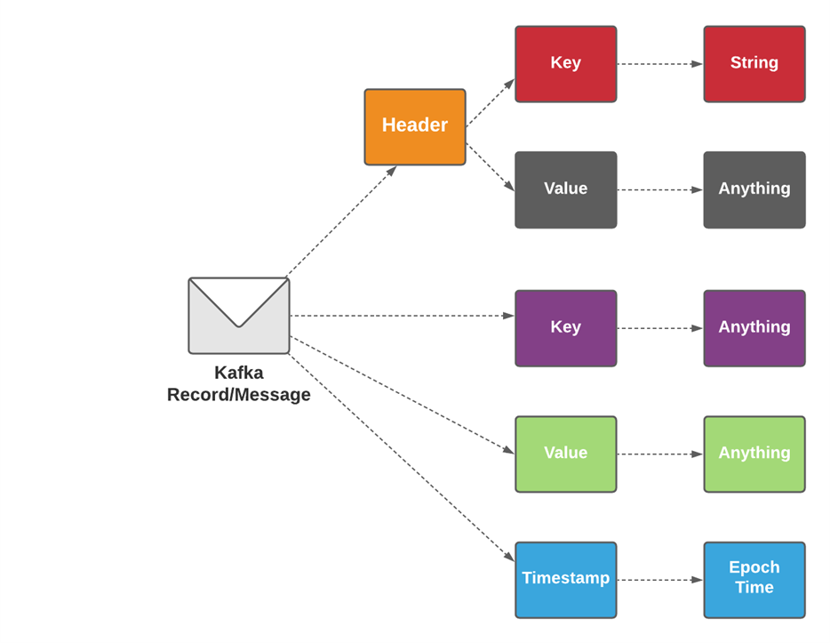
Kafka and Events – Key/Value Pairs
Kafka is based on the abstraction of a distributed commit log.
By splitting a log into partitions, Kafka is able to scale-out systems.
As such, Kafka models events as key/value pairs. Internally, keys and values are just sequences of bytes, but externally in your programming language of choice, they are often structured objects represented in your language’s type system.
Kafka famously calls the translation between language types and internal bytes serialization and deserialization.
The serialized format is usually JSON, JSON Schema, Avro, or Protobuf.
Values are typically the serialized representation of an application domain object or some form of raw message input, like the output of a sensor.

Slide 109
Event Streaming Platform
Kafka combines three key capabilities so you can implement your use cases for event streaming end-to-end with a single battle-tested solution:
To publish (write) and subscribe to (read) streams of events, including continuous import/export of your data from other systems.
To store streams of events durably and reliably for as long as you want.
To process streams of events as they occur or retrospectively.
And all this functionality is provided in a distributed, highly scalable, elastic, fault-tolerant, and secure manner.
Kafka can be deployed on bare-metal hardware, virtual machines, and containers, and on-premises as well as in the cloud.
You can choose between self-managing your Kafka environments and using fully managed services offered by a variety of vendors.

Slide 110
Events
An event records the fact that "something happened" in the world or in your business.
It is also called record or message in the documentation.
When you read or write data to Kafka, you do this in the form of events. Conceptually, an event has a key, value, timestamp, and optional metadata headers.
Here's an example event:
Event key: "Alice"
Event value: "Made a payment of $200"
Event timestamp: "Jun. 25, 2020 at 2:06 p.m."

Slide 111
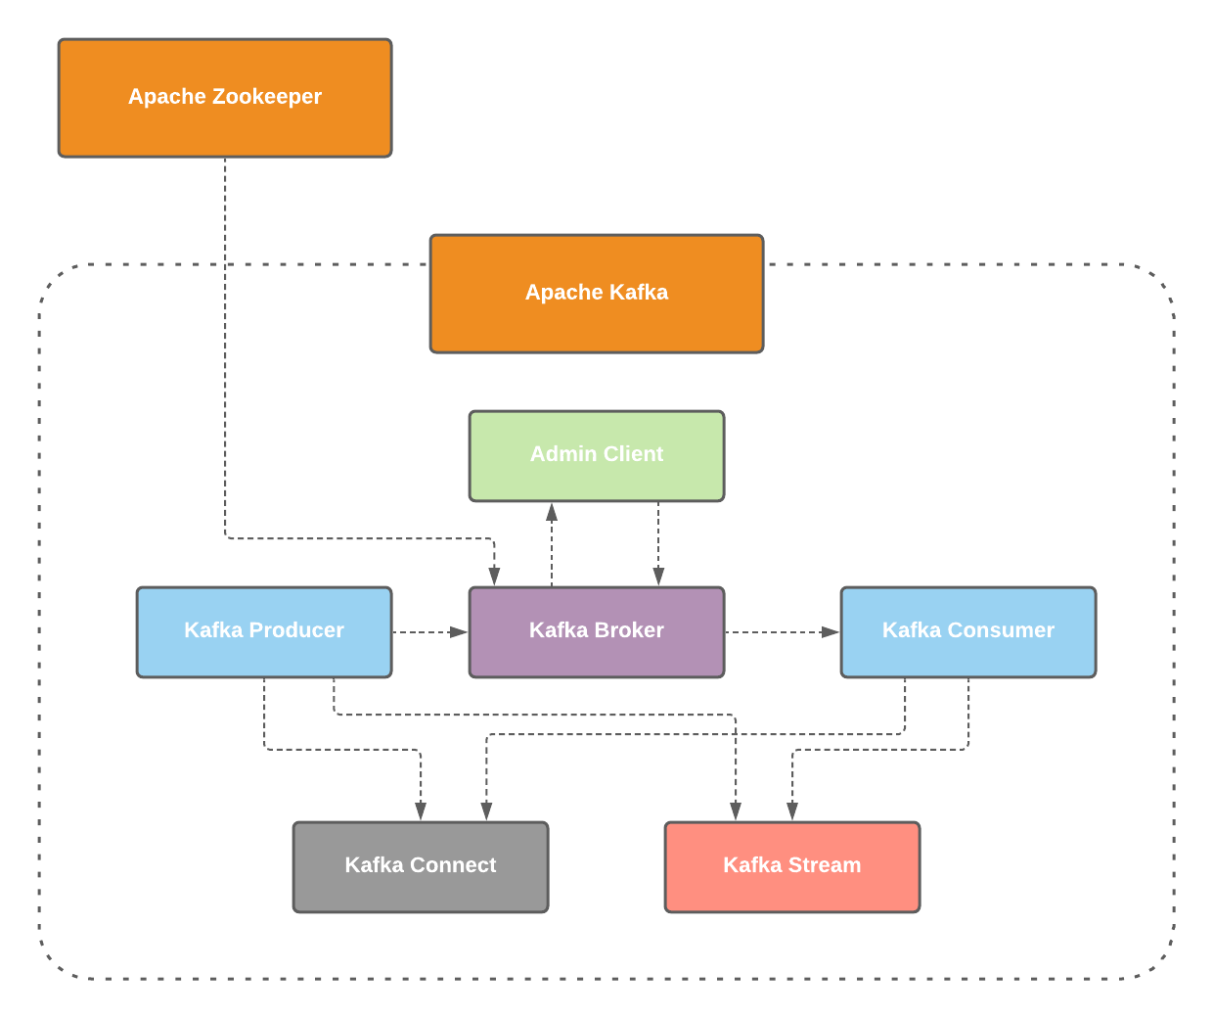
Architecture

Slide 112

How does it work
Kafka is a distributed system consisting of servers and clients that communicate via a high-performance TCP network protocol.
It can be deployed on bare-metal hardware, virtual machines, and containers in on-premise as well as cloud environments.

Slide 113
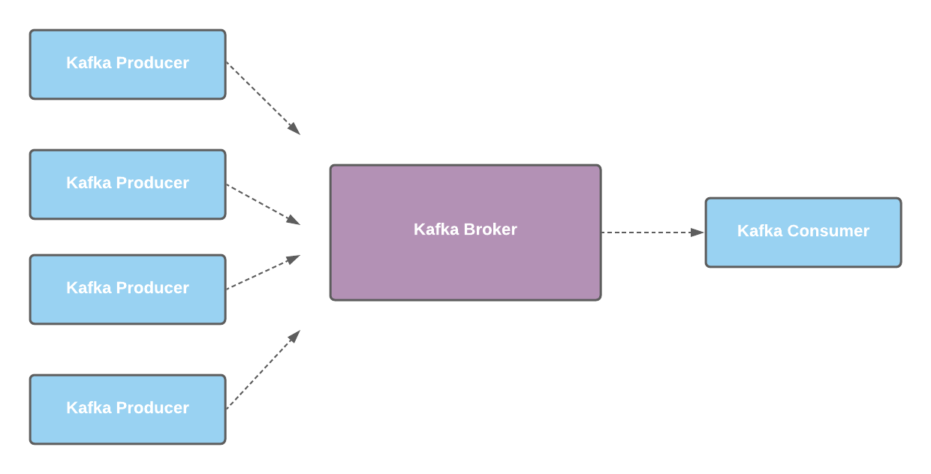
Kafka Client Server
Servers: Kafka is run as a cluster of one or more servers that can span multiple datacenters or cloud regions.
Some of these servers form the storage layer, called the brokers.
Other servers run Kafka Connect to continuously import and export data as event streams to integrate Kafka with your existing systems such as relational databases as well as other Kafka clusters.
To let you implement mission-critical use cases, a Kafka cluster is highly scalable and fault-tolerant:
If any of its servers fails, the other servers will take over their work to ensure continuous operations without any data loss.
Client
Server
Client

Slide 114

How does it work
Clients: They allow you to write distributed applications and microservices that read, write, and process streams of events in parallel, at scale, and in a fault-tolerant manner even in the case of network problems or machine failures.
Kafka ships with some such clients included, which are augmented by dozens of clients provided by the Kafka community:
Clients are available for Java and Scala including the higher-level Kafka Streams library, for Go, Python, C/C++, and many other programming languages as well as REST APIs.
Client
Server
Client

Slide 115
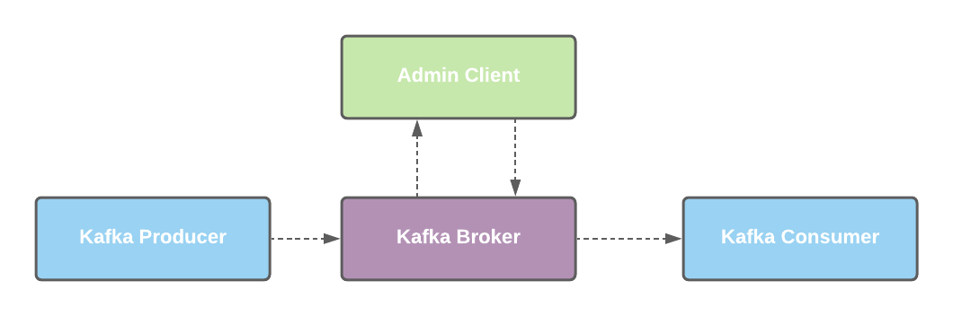
Admin Client
Admin Client
Creating Topics
Configuration Operations

Slide 116
Producer
Producers are those client applications that publish (write) events to Kafka, and consumers are those that subscribe to (read and process) these events.
In Kafka, producers and consumers are fully decoupled and agnostic of each other, which is a key design element to achieve the high scalability that Kafka is known for.
For example, producers never need to wait for consumers.
Kafka provides various guarantees such as the ability to process events exactly-once.

Slide 117
Producer
Load balancing
The producer sends data directly to the broker that is the leader for the partition without any intervening routing tier.
To help the producer do this all Kafka nodes can answer a request for metadata about which servers are alive and where the leaders for the partitions of a topic are at any given time to allow the producer to appropriately direct its requests.
The producer client controls which partition it publishes messages to.
This can be done at random, implementing a kind of random load balancing, or it can be done by some semantic partitioning function.
Metadata for all topics (from broker 1: broker-1:9092/1):
3 brokers:
broker 1 at broker-1:9092
broker 2 at broker-2:9093
broker 3 at broker-3:9094
1 topic:
topic ”servings" with 3 partitions:
partition 0, leader 2, replicas: 1,2,3

Slide 118
Producer
Load balancing
We expose the interface for semantic partitioning by allowing the user to specify a key to partition by and using this to hash to a partition (there is also an option to override the partition function if need be).
For example if the key chosen was a user id then all data for a given user would be sent to the same partition.
This in turn will allow consumers to make locality assumptions about their consumption. This style of partitioning is explicitly designed to allow locality-sensitive processing in consumers.

Slide 119
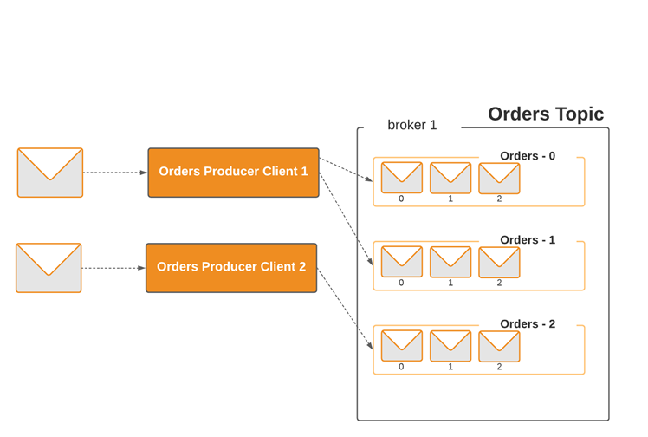
Producer and Events
Events are organized and durably stored in topics.
Very simplified, a topic is similar to a folder in a filesystem, and the events are the files in that folder.
An example topic name could be “orders".
Topics in Kafka are always multi-producer and multi-subscriber: a topic can have zero, one, or many producers that write events to it, as well as zero, one, or many consumers that subscribe to these events.
Events in a topic can be read as often as needed—unlike traditional messaging systems, events are not deleted after consumption.
Instead, you define for how long Kafka should retain your events through a per-topic configuration setting, after which old events will be discarded.
Kafka's performance is effectively constant with respect to data size, so storing data for a long time is perfectly fine.

Slide 120
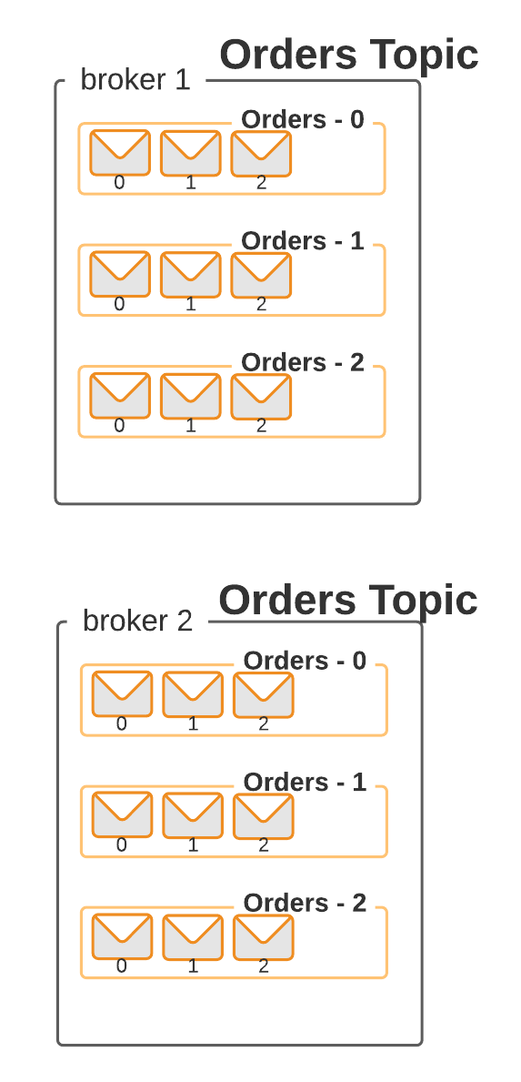
Partition
Topics are partitioned, meaning a topic is spread over a number of "buckets" located on different Kafka brokers.
This distributed placement of your data is very important for scalability because it allows client applications to both read and write the data from/to many brokers at the same time.
When a new event is published to a topic, it is actually appended to one of the topic's partitions.
Events with the same event key (e.g., a customer or vehicle ID) are written to the same partition, and Kafka guarantees that any consumer of a given topic-partition will always read that partition's events in exactly the same order as they were written.

Slide 121
Replication
To make your data fault-tolerant and highly-available, every topic can be replicated, even across geo-regions or datacenters,
So that there are always multiple brokers that have a copy of the data just in case things go wrong
A common production setting is a replication factor of 3, i.e., there will always be three copies of your data.
This replication is performed at the level of topic-partitions.

Slide 122
Asynchronous send
Batching is one of the big drivers of efficiency, and to enable batching the Kafka producer will attempt to accumulate data in memory and to send out larger batches in a single request.
The batching can be configured to accumulate no more than a fixed number of messages and to wait no longer than some fixed latency bound (say 64k or 10 ms).
This allows the accumulation of more bytes to send, and few larger I/O operations on the servers.
This buffering is configurable and gives a mechanism to trade off a small amount of additional latency for better throughput.
Details on configuration and the api for the producer can be found elsewhere in the documentation.

Slide 123
Cunsumer
The Kafka consumer works by issuing "fetch" requests to the brokers leading the partitions it wants to consume.
The consumer specifies its offset in the log with each request and receives back a chunk of log beginning from that position.
The consumer thus has significant control over this position and can rewind it to re-consume data if need be.

Slide 124
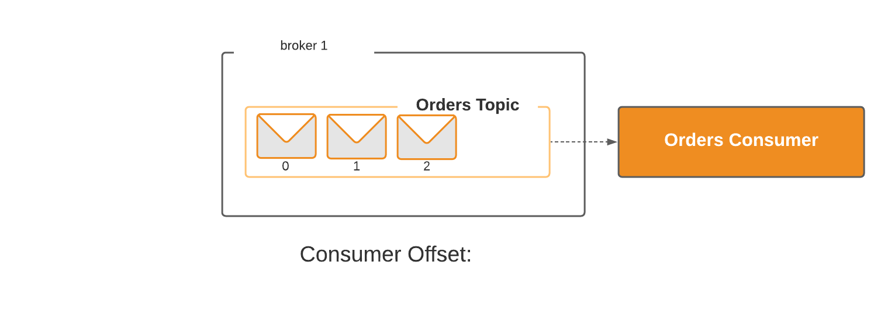

Offset
The Kafka consumer works by issuing "fetch" requests to the brokers leading the partitions it wants to consume.
The consumer specifies its offset in the log with each request and receives back a chunk of log beginning from that position.
The consumer thus has significant control over this position and can rewind it to re-consume data if need be.
2
1
0

Slide 125
Push vs. Pull
An initial question we considered is whether consumers should pull data from brokers or brokers should push data to the consumer.
In this respect Kafka follows a more traditional design, shared by most messaging systems, where data is pushed to the broker from the producer and pulled from the broker by the consumer.
Some logging-centric systems, such as Scribe and Apache Flume, follow a very different push-based path where data is pushed downstream.
There are pros and cons to both approaches.
However, a push-based system has difficulty dealing with diverse consumers as the broker controls the rate at which data is transferred.

Slide 126
Push vs. Pull
The goal is generally for the consumer to be able to consume at the maximum possible rate; unfortunately, in a push system this means the consumer tends to be overwhelmed when its rate of consumption falls below the rate of production (a denial of service attack, in essence).
A pull-based system has the nicer property that the consumer simply falls behind and catches up when it can.
This can be mitigated with some kind of backoff protocol by which the consumer can indicate it is overwhelmed, but getting the rate of transfer to fully utilize (but never over-utilize) the consumer is trickier than it seems.
Previous attempts at building systems in this fashion led us to go with a more traditional pull model.

Slide 127
Push vs. Pull
Another advantage of a pull-based system is that it lends itself to aggressive batching of data sent to the consumer.
A push-based system must choose to either send a request immediately or accumulate more data and then send it later without knowledge of whether the downstream consumer will be able to immediately process it. If tuned for low latency, this will result in sending a single message at a time only for the transfer to end up being buffered anyway, which is wasteful.
A pull-based design fixes this as the consumer always pulls all available messages after its current position in the log (or up to some configurable max size).
So one gets optimal batching without introducing unnecessary latency.

Slide 128
Push vs. Pull
The deficiency of a naive pull-based system is that if the broker has no data the consumer may end up polling in a tight loop, effectively busy-waiting for data to arrive.
To avoid this we have parameters in our pull request that allow the consumer request to block in a "long poll" waiting until data arrives (and optionally waiting until a given number of bytes is available to ensure large transfer sizes).
You could imagine other possible designs which would be only pull, end-to-end.
The producer would locally write to a local log, and brokers would pull from that with consumers pulling from them. A similar type of "store-and-forward" producer is often proposed.

Slide 129
Push vs. Pull
This is intriguing but we felt not very suitable for our target use cases which have thousands of producers.
Our experience running persistent data systems at scale led us to feel that involving thousands of disks in the system across many applications would not actually make things more reliable and would be a nightmare to operate.
And in practice we have found that we can run a pipeline with strong SLAs at large scale without a need for producer persistence.

Slide 130
Consumer Position
Keeping track of what has been consumed is, surprisingly, one of the key performance points of a messaging system.
Most messaging systems keep metadata about what messages have been consumed on the broker.
That is, as a message is handed out to a consumer, the broker either records that fact locally immediately or it may wait for acknowledgement from the consumer.
This is a fairly intuitive choice, and indeed for a single machine server it is not clear where else this state could go.
Since the data structures used for storage in many messaging systems scale poorly, this is also a pragmatic choice--since the broker knows what is consumed it can immediately delete it, keeping the data size small.

Slide 131
Consumer Position
What is perhaps not obvious is that getting the broker and consumer to come into agreement about what has been consumed is not a trivial problem.
If the broker records a message as consumed immediately every time it is handed out over the network, then if the consumer fails to process the message (say because it crashes or the request times out or whatever) that message will be lost.
To solve this problem, many messaging systems add an acknowledgement feature which means that messages are only marked as sent not consumed when they are sent; the broker waits for a specific acknowledgement from the consumer to record the message as consumed.
This strategy fixes the problem of losing messages, but creates new problems.

Slide 132
Offset
2
1
0

Slide 133
Consumer Position
First of all, if the consumer processes the message but fails before it can send an acknowledgement then the message will be consumed twice.
The second problem is around performance, now the broker must keep multiple states about every single message (first to lock it so it is not given out a second time, and then to mark it as permanently consumed so that it can be removed).
Tricky problems must be dealt with, like what to do with messages that are sent but never acknowledged.
Kafka handles this differently:
Our topic is divided into a set of totally ordered partitions, each of which is consumed by exactly one consumer within each subscribing consumer group at any given time.

Slide 134
Consumer Position
This means that the position of a consumer in each partition is just a single integer, the offset of the next message to consume.
This makes the state about what has been consumed very small, just one number for each partition.
This state can be periodically checkpointed.
This makes the equivalent of message acknowledgements very cheap.
There is a side benefit of this decision.

Slide 135
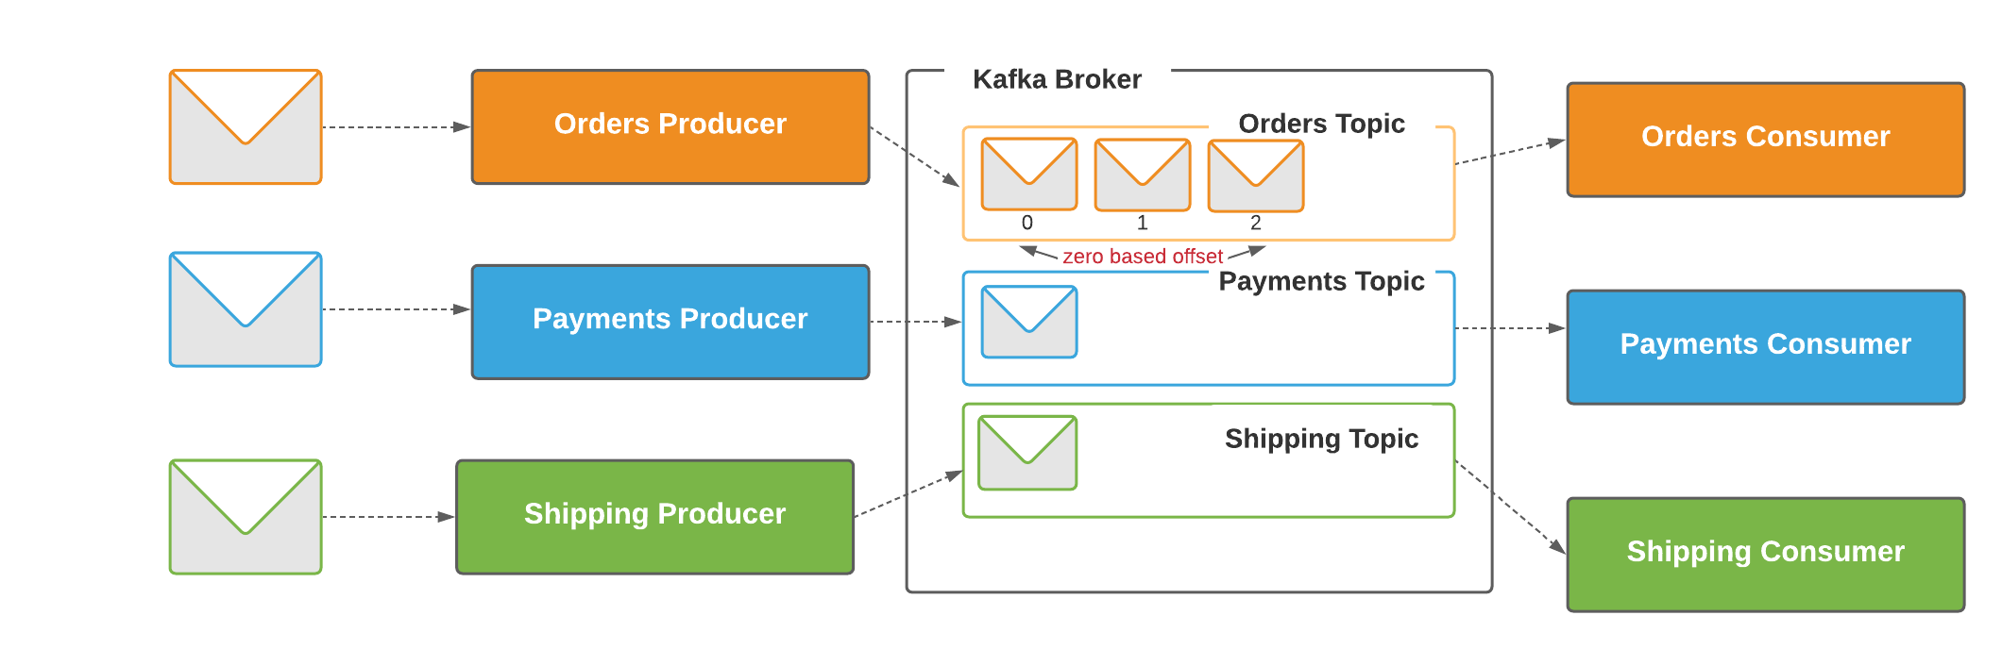
Zero Based Offset

Slide 136
Consumer Position
A consumer can deliberately rewind back to an old offset and re-consume data.
This violates the common contract of a queue, but turns out to be an essential feature for many consumers.
For example, if the consumer code has a bug and is discovered after some messages are consumed, the consumer can re-consume those messages once the bug is fixed.

Slide 137
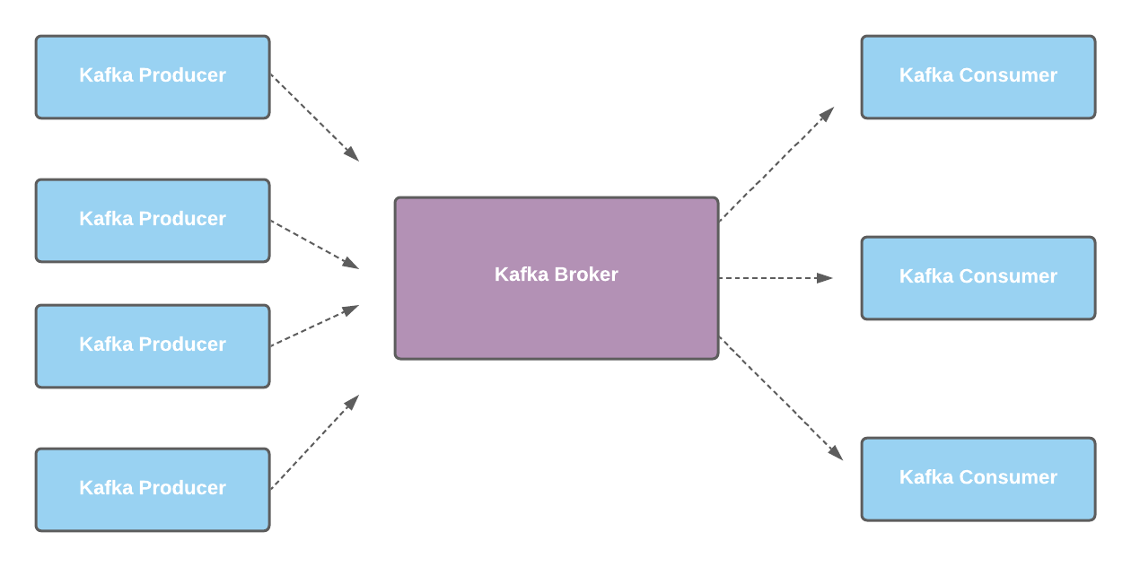
Kafka Producers and Cosumers

Slide 138
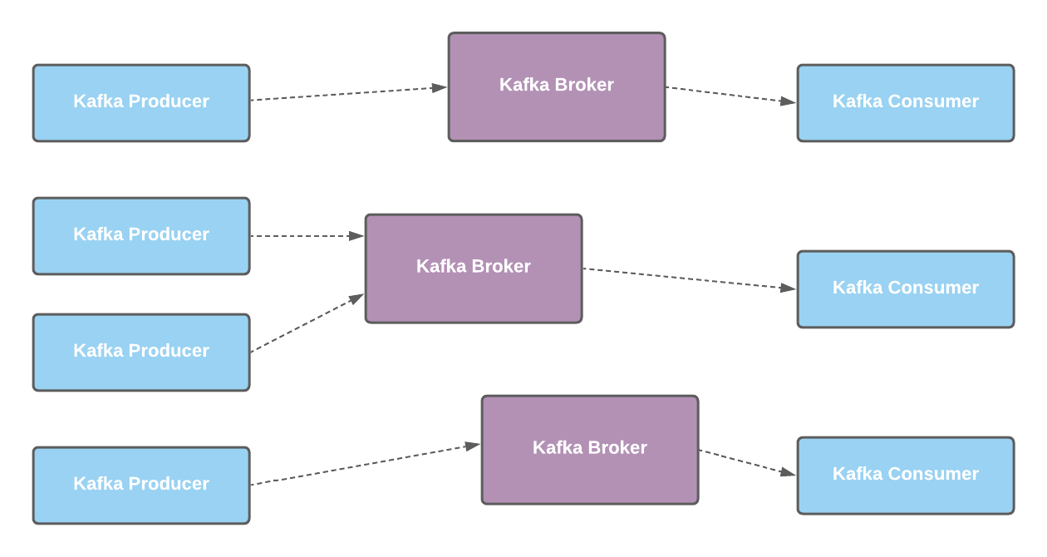
Kafka Broker Scaled

Slide 139
Topics
Events are organized and durably stored in topics.
Very simplified, a topic is similar to a folder in a filesystem, and the events are the files in that folder. An example topic name could be "payments".
Topics in Kafka are always multi-producer and multi-subscriber: a topic can have zero, one, or many producers that write events to it, as well as zero, one, or many consumers that subscribe to these events.
Events in a topic can be read as often as needed—unlike traditional messaging systems, events are not deleted after consumption.
Instead, you define for how long Kafka should retain your events through a per-topic configuration setting, after which old events will be discarded.
Kafka's performance is effectively constant with respect to data size, so storing data for a long time is perfectly fine.

Slide 140
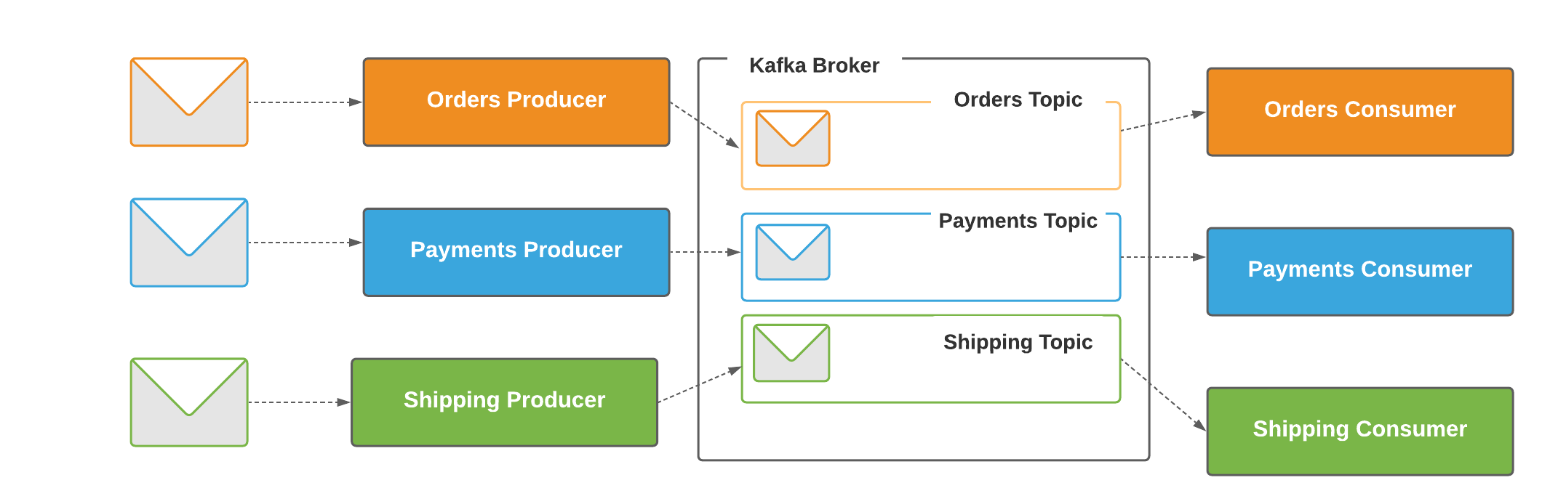
Topics

Slide 141
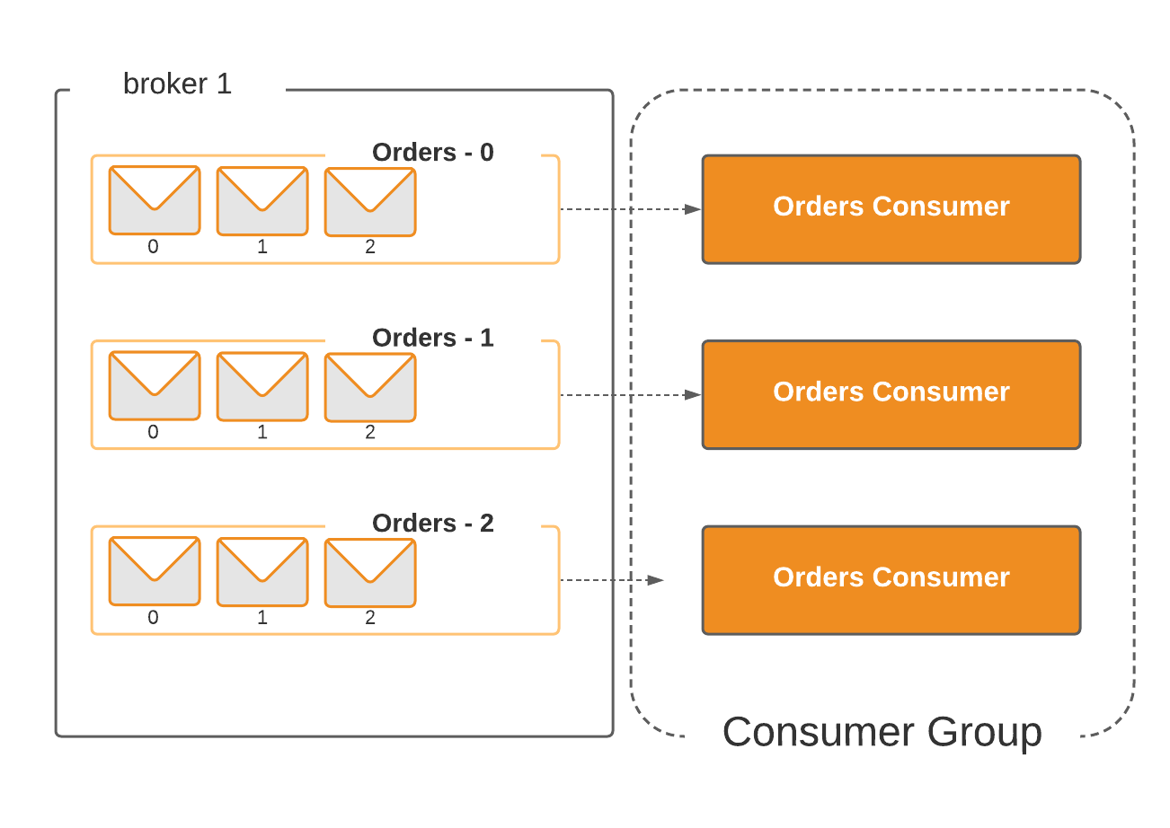

Slide 142
Zero Based Offset

Slide 143
Kafka Record/Message

Slide 144
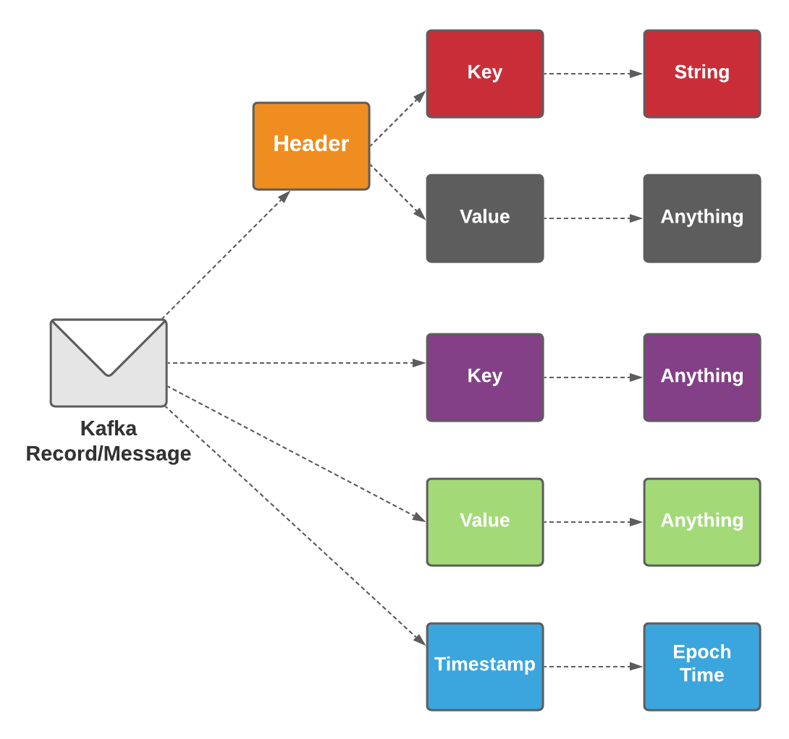
Kafka and Events – Key/Value Pairs
Keys can also be complex domain objects but are often primitive types like strings or integers.
The key part of a Kafka event is not necessarily a unique identifier for the event, like the primary key of a row in a relational database would be.
It is more likely the identifier of some entity in the system, like a user, order, or a particular connected device.
This may not sound so significant now, but we’ll see later on that keys are crucial for how Kafka deals with things like parallelization and data locality.

Slide 145
Slide header
Column header
Column header
Bullet points
Bullet points

Slide 146
Slide header
Column header
Column header
Column header
Column header
Bullet points or text
Bullet points or text
Bullet points or text
Bullet points or text

Slide 147
Slide header
Descriptive text in sentence form with some details, highlighted text or callouts.
Descriptive text in sentence form with some details, highlighted text or callouts.
Descriptive text in sentence form with some details, highlighted text or callouts.
Descriptive text in sentence form with some details, highlighted text or callouts.
Descriptive text in sentence form with some details, highlighted text or callouts.
Descriptive text in sentence form with some details, highlighted text or callouts.
Descriptive text in sentence form with some details, highlighted text or callouts.
Descriptive text in sentence form with some details, highlighted text or callouts.

Slide 148

Thank you

Slide 149
Appendix

Slide 150
Icons Icons should be primarily used as a visual aid, as a way to break up large amounts of text and content, or as a visual cue of the content that follows. Get the full set of icons for presentations
INDUSTRY SECTORS
Aeronautics | Agriculture | Architecture | Automotive | Construction | Education and research | Energy | Financial services | Healthcare | Engineering and manufacturing | Professional services, media | Sports
Government | Retail | Technology | Media and broadcasting | Travel and transportation | Education | Law | Science | - | - | - | -
MAPS / LOCATION
Globe, global, earth | Globe, global, earth | Navigation, GPS, POI, location, map | Map, location, GPS, directions, navigation | Navigation, GPS, POI, location, map | Map, location, route, quest, destination, journey | Download map, receive location | - | - | - | - | -
MONEY / FINANACE / RETAIL / CONSUMER
Shopping cart, store | Store, bag, shop | Money, dollar sign, cash, revenue, currency | Revenue, financial report, funds | Money, currency, coins | Bank, piggybank | Compare, balance, finance, justice | Credit card, payment, charge, debit card | Mobile payment, digital payment, e-commerce | Barcode scanner | Tag, sale, shopping | Bank

Slide 151
Get the full set of icons for presentations
OBJECTS / TOOLS
Alarm clock | Hourglass, timer | Clock | Flashlight | Funnel | Calculator | Binoculars | Scissors | Camera | Battery, power, charge | Magnifying glass | Tools, screwdriver, wrench
Paperclip | Pushpin, thumbtack | Key | Lock | Safe | Piggybank | Bag | Ballot box, drop box | Box, archive, storage | Present, giftbox | Box, package, shipping | Briefcase, business, work, job
Books, reading | Book, dictionary, novel | Notebook, journal | Pencil | Paintbrush | Paint palette, color | 3D, hologram | Trophy, award | Ribbon, award, reward, accomplishment | Ribbon, award, reward, accomplishment | Flag, finish line | Flags, finish line, win, race
Open door, entryway, opportunity | Clipboard | Megaphone, speaker, speech, announcement | Microphone | CD, music album | Headphones | Headset | Eye glasses | Bike, bicycle | Umbrella, bumbershoot | Balloon, party, celebration | Rocking chair
Remote control | Robotic, manufacturing, mechanical, automation | Forklift | Gears | Traffic cone, construction | Flask, chemistry, science, beaker | Maze, puzzle | Target, bullseye, aim, arrow, dartboard, darts, archery | Games, strategy, chess, poker | Musical instrument, drums | Pizza, food | Lightbulb

Slide 152
Presentation resources
More templates
Training
Overview of templates on Brand Central
Product-specific PowerPoint templates
PowerPoint presentation event templates
Past event slides archive
Microsoft Story deck
Toolkit for building your own template
Brand Central presentations overview page
Accessibility tips and best practices

Slide 153

Section divider title

Slide 154

Section divider title

Slide 155

Section divider title

Slide 156

Section divider title

Slide 157

Section divider title

Slide 158

Section divider title

Slide 159

Section divider title

Slide 160

Section divider title

Slide 161

Section divider title

Slide 162

Section divider title

